Slide 1
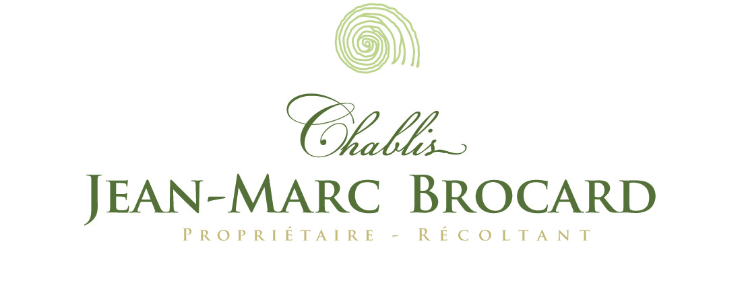

Slide 2
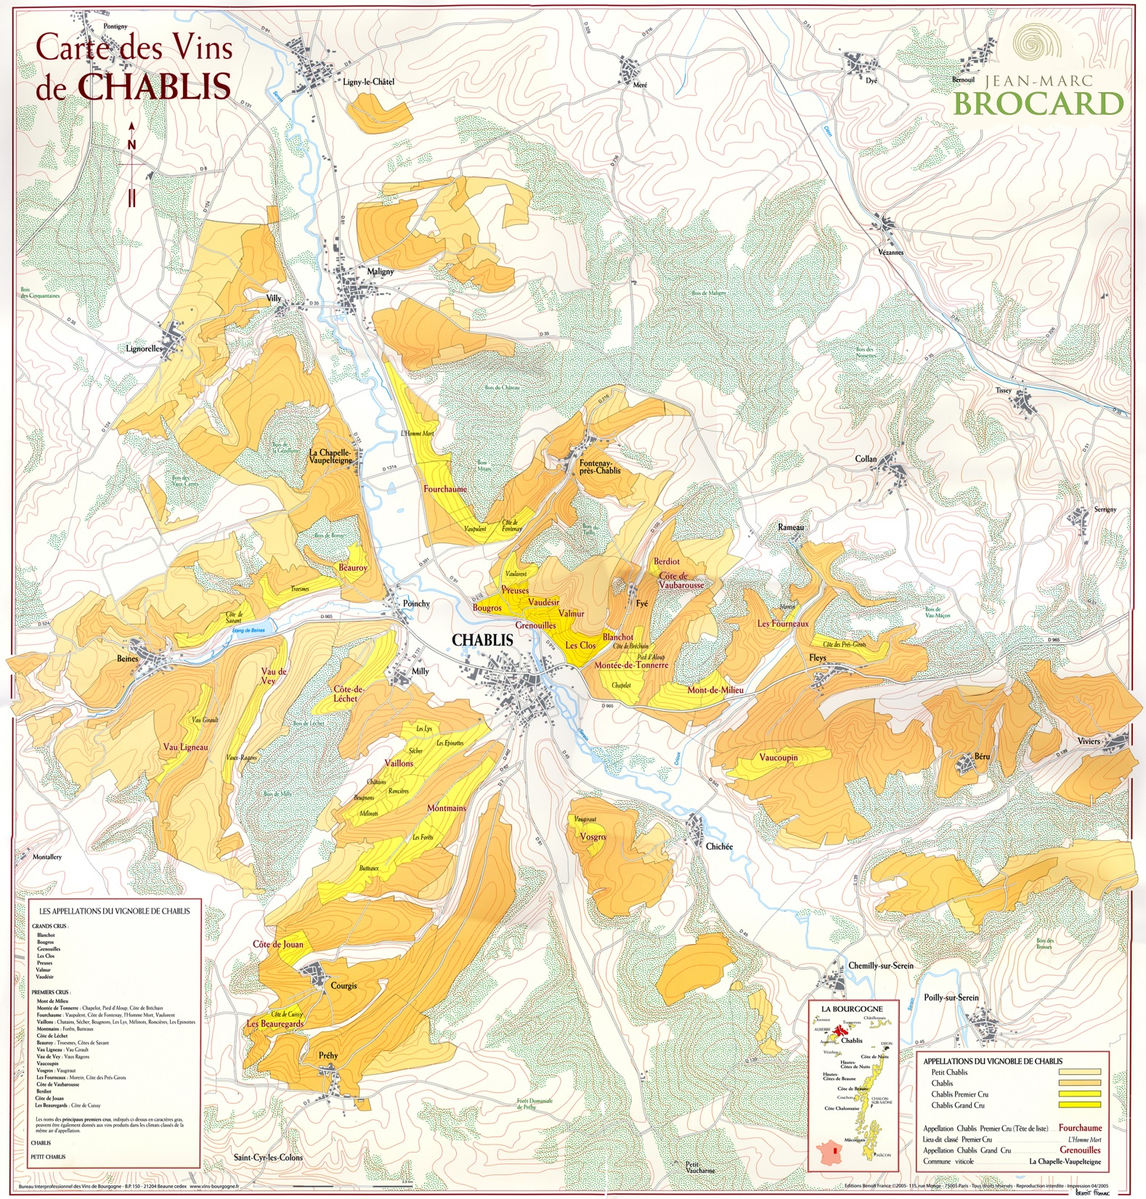
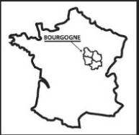

Slide 3
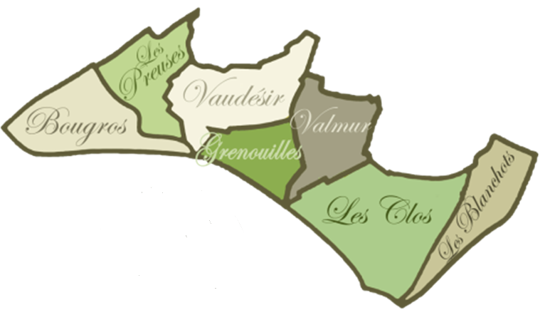
Chablis Grand Cru

Slide 4
IDENTITY
Created in 1973 by Jean-Marc Brocard.
The domain produces unique wines from
the unique terroir " Kimmeridgian " and
its single grape " Chardonnay “.
In 40 years, Jean-Marc Brocard winery became the biggest family producer in Chablis

Slide 5
Family winery Father & Son

Slide 6
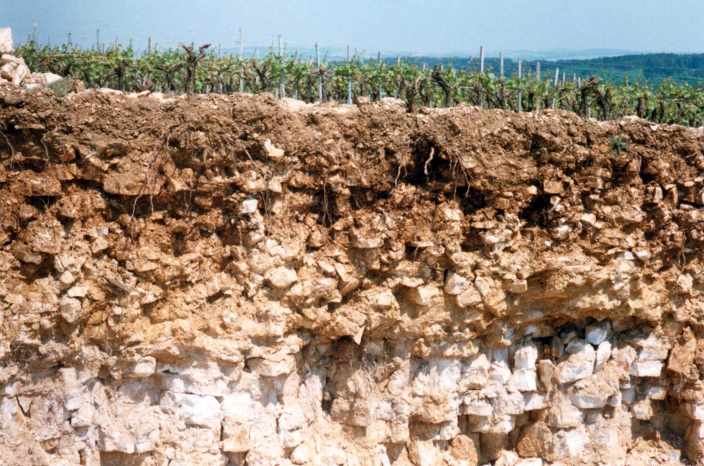
Kimmeridgian soil : clay and limestone from Upper Jurassic, which gives to Chablis wine its fresh minerality
Soil cutting with roots
Exogyra Virgula (oysters) : marine fossils from kimmeridgian soil

Slide 7
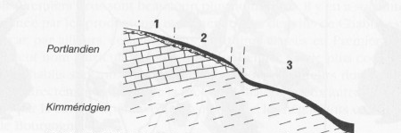
Petit Chablis/Chablis

Slide 8
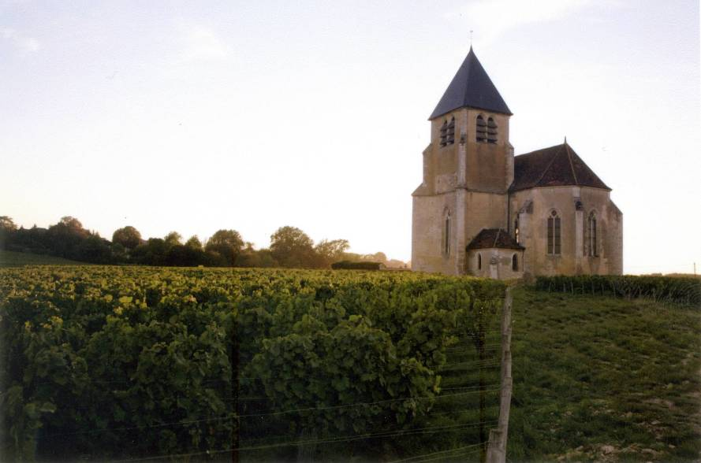
The 15th-century-church Sainte-Claire
which gives its name to Domaine Sainte Claire,
Petit Chablis and Chablis first vines of Jean-Marc Brocard

Slide 9
Organic wines
Since 1997
“We recreated ecological niches by planting trees in the area, thus bringing back some birds, beneficial predators.”
Nature rewarded us by offering us pure, precise and complex wines.

Slide 10
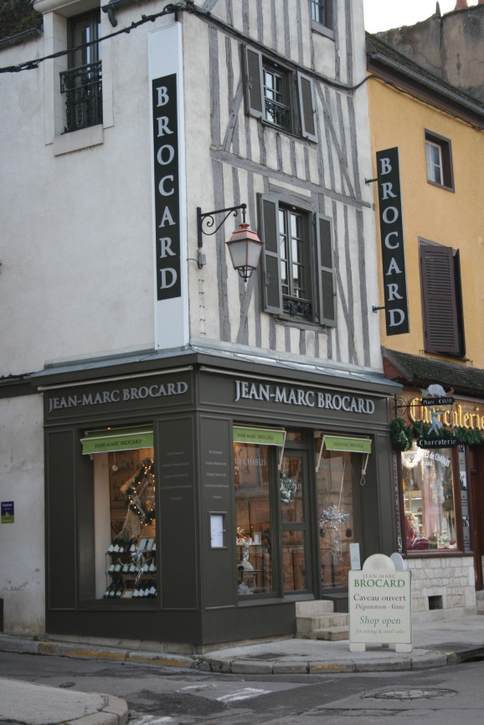
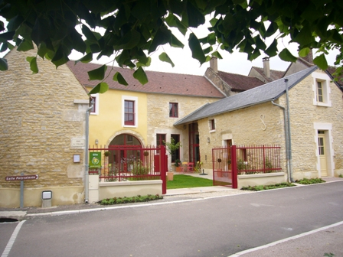
Guesthouse
Oenotourism
Wine shop

Slide 11
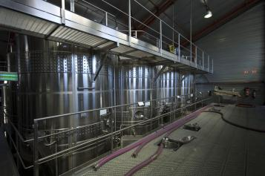
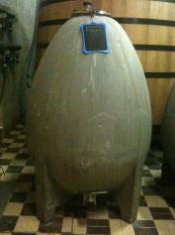
Vinification
Each plot is vinified separately in order to keep each terroir’s authenticity unspoiled.
This simply means treating, helping and especially avoiding forcing flavours to make them into what we want them to be.
These striking wines literally invite you to come and explore the purest expression of their climate

Slide 12
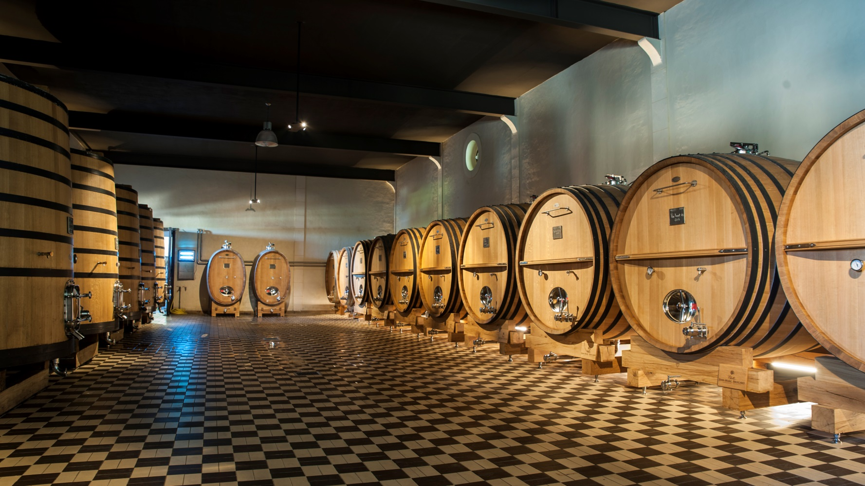
Salle des foudres
Vinification

Slide 13
Jean-Marc BROCARD : a premium brand
Distribution channels
Off premise | On premise | Retails/travel Business
Independent wine shops, chains (whole foods), gourmet food store | Restaurants, hotels, wine-bars, chains etc… | Airlines (first class), duty free shops, cruise lines.

Slide 14
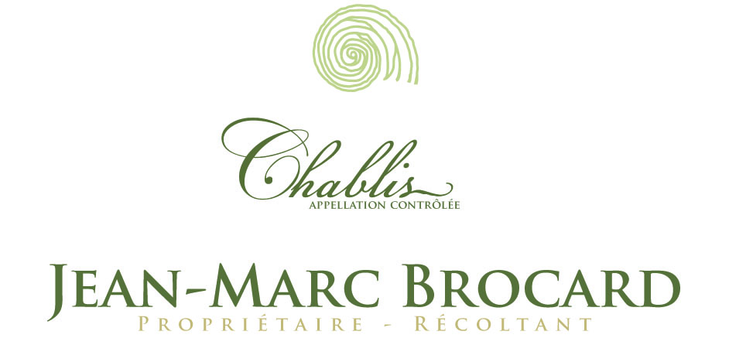
Internationally recognized & distributed top Chablis Estate;
Leader in many quality markets and present in over 50 countries in all the main areas;
Family Domain extending over 150 hectares, a leader in organic farming in Chablis;
Strong Brand renowned as Chablis specialists..
Figures
Export turnover rate: 80%
Local turnover rate: 20%
Production
Jean-Marc Brocard wines: 80 000 cases
Surface area: 150 hectares
66 certified organic hectares

Slide 15
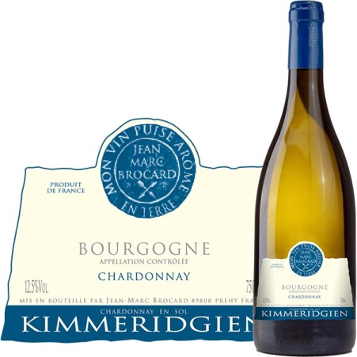
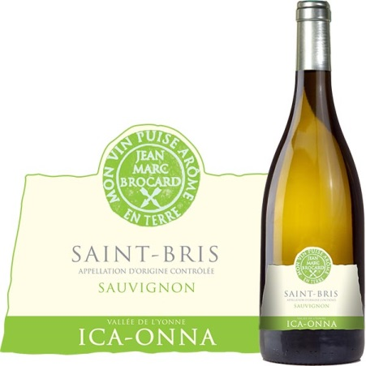
Jean-Marc BROCARD : by Vasco

