Slide 1
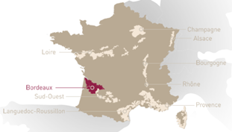
Name of the House
LOGO
Country
AOC
Pictures of
The château / principal building
The vineyards
The region

Slide 2
History of the House
A family / a person
A date
Pictures
General winClimatee making principles of the house
What are the main cépages used?
Own grapes / bought grapes?
BIO? Biodynamie?
Special winemaking techniques of the region
Types of wines produced
Sparkling
White
Rosé
Red
Others (fortified, orange, …)

Slide 3
Construction of the range (if applicable): just mention the principles, not a full explanation of every wine in the range. Explain that the range is split in different categories + Some pictures of the bottles
E.g. Bertani
Due Uve Series
Heart of Valpolicella
Amarone World
Vintage / Heritage
Or Taittinger
Brut Réserve and Rosé Prestige
Special Cuvées (Millésimé, Folies, …)
Comtes de Champagne
Or Gérard Bertrand
Bocada / Polinat
Gris Blanc / Extra Blanc
Réserve Spéciale / Prima Nature / Héritage
Different domains
Clos d’Ora, Clos du Temple
One wine you want to put in the picture
Name of the wine
Why this wine (best seller, typical of the region, unique…)
Composition and wine making technique

Slide 4
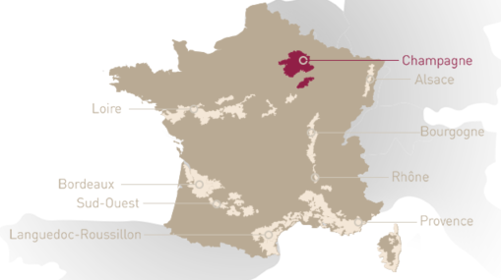
Name
Picture setting the scene
LOGO
Picture of the range
Cépages blanc
…
…
Cépages Rouge
…
…
Basis :
Premium
Luxe :
Pays :
Région :
Appelation :
Owners :
Founded in …
# Ha : … Ha
Specificity differentiating from competition

