Slide 1
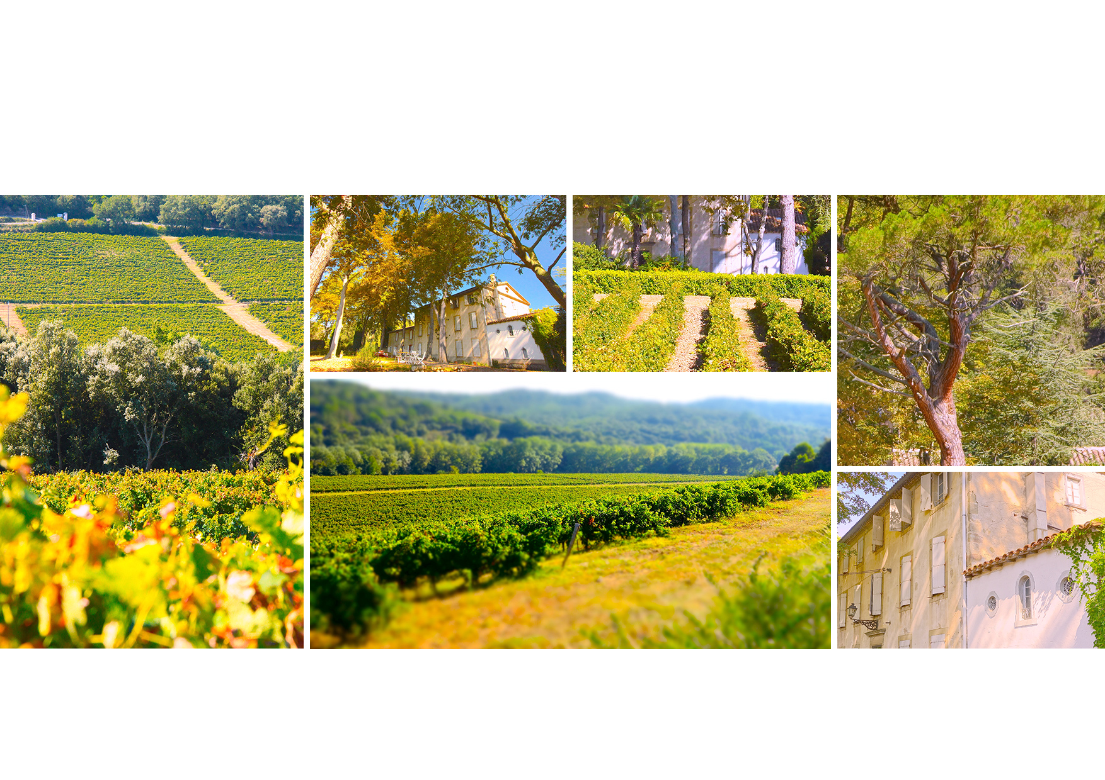
GRAND VIN
CHÂTEAU DE LA SOUJEOLE

Slide 2
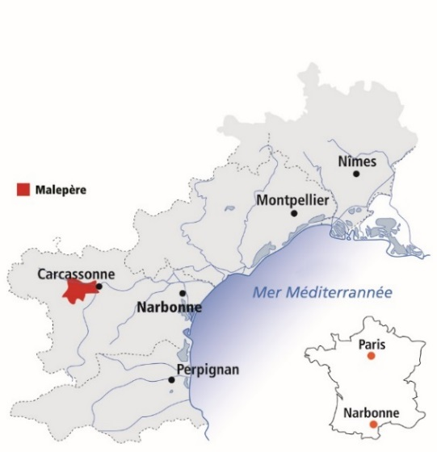
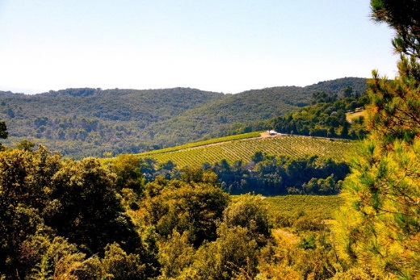
GRAND VIN
CHÂTEAU DE LA SOUJEOLE GRAND VIN
AOP MALEPERE
MERLOT, CABERNET FRANC, MALBEC
La Soujeole Grands Vins are elaborated with the best grapes and barrels of the estate.
Château de La Soujeole is located in the Malepère appellation, bordered to the west by Castelnaudary, to the east by Carcassonne and to the South by Limoux.
The vineyard is planted near the famous «Cité médiévale de Carcassonne» (XIIthCentury).
La Malepère is a region where the influences of the South-West (Oceanic climate) meet the Mediterranean climate. This terroir is ideal to obtain a great expression of the South West varietal, and especially the Cabernet Franc.
Thanks to the influences of the Mediterranean Sea we have high temperatures during Summer and Autumn allowing us to harvest ripen grapes and so reveal wines with more concentration.
The estate is committed to biodynamics.
Vineyard since 1740
Kingdom of cabernet franc
Door between worlds
Atlantic meets mediterranean
A wine of balance
1st MALEPERE WINE TO BE SERVED ON AIR FRANCE BUSINESS CLASS IN 2015
A SELECTION BY PAOLO BASSO

