Slide 1
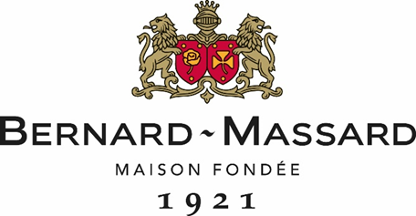
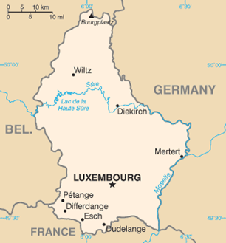
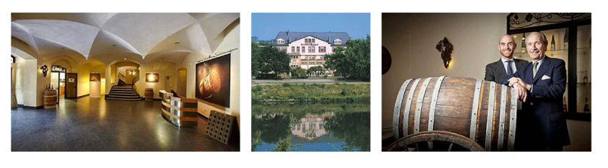
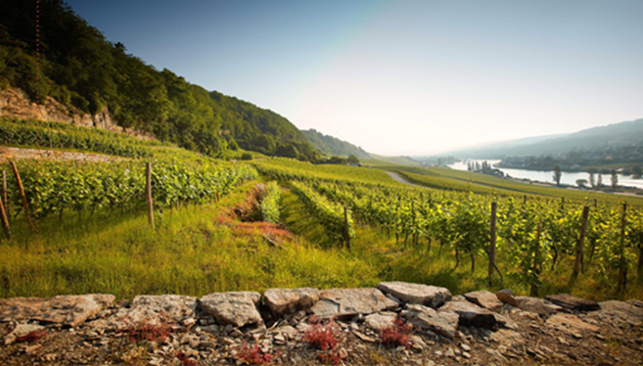

Luxembourg (GrevenMacher)
Fête ses 100 Ans
Méthode Traditionnelle

Slide 2
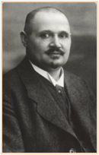
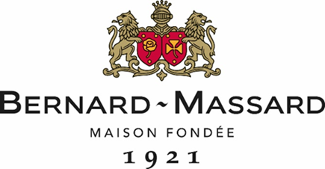
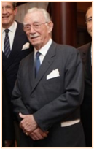
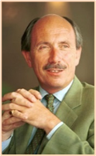
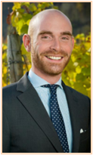
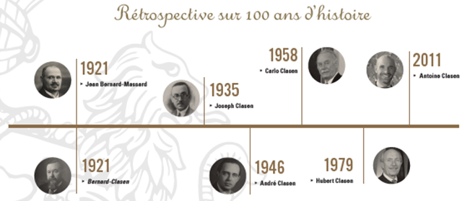
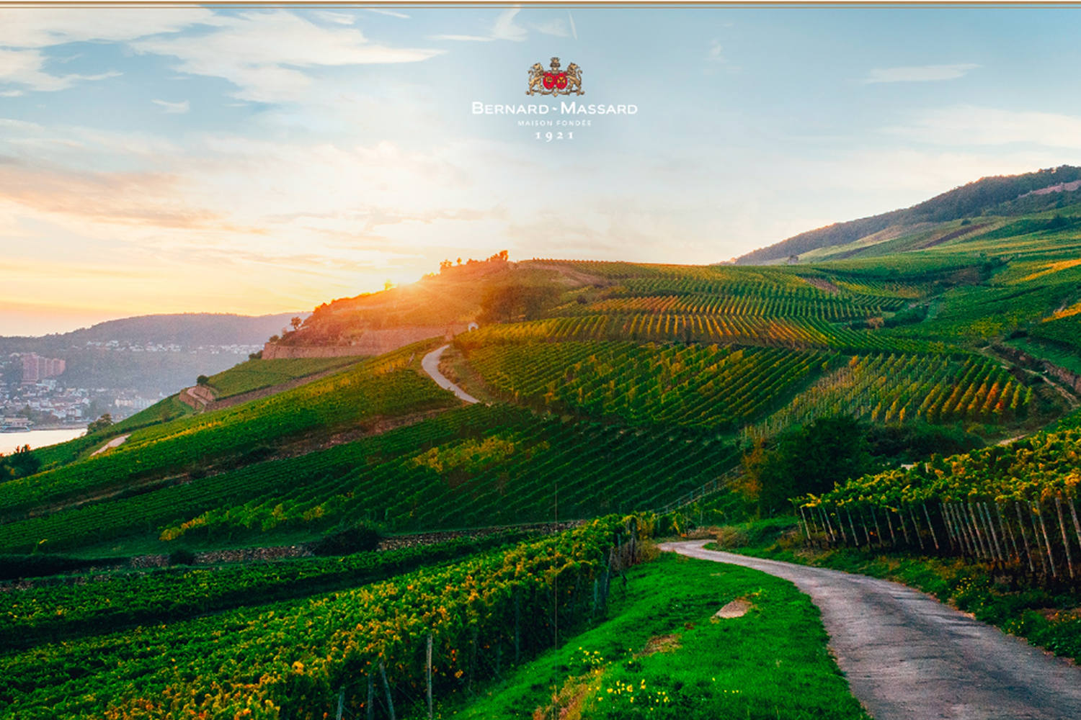
History of the House
  Jean Bernard-Massard is the founder
  Stage in champagne come back to Luxembourg during War
  100th Anniversary of the company in 2021
  Family Clasen sinds 5 generations
  Now Antoine Clasen and his father have the lead
General wine making principles of the house
  Cépages: Predominance of Riesling, Pinot Gris, Pinot Blanc
  35 ha of own vineyards along Moselle (micro climat)
  3.500.000 bottles/year – exported in 20 countries
  700.000 bottles in Belgium (650.000 in OFF TRADE)
  Méthode traditionnelle
  Types of wines produced
    Sparkling & still wines

Slide 3
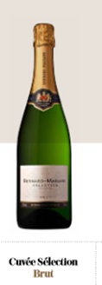
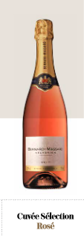
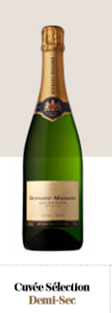
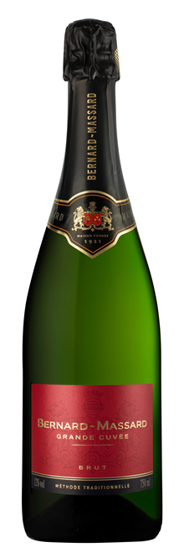
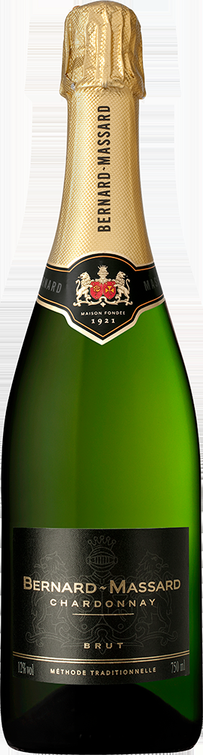
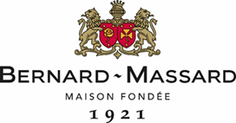
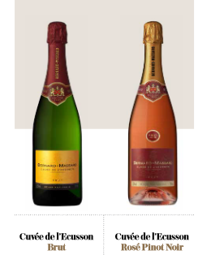
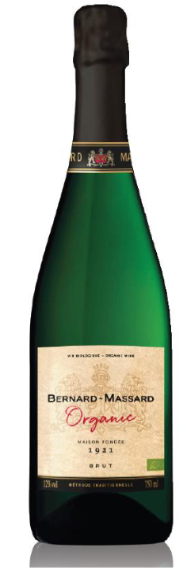
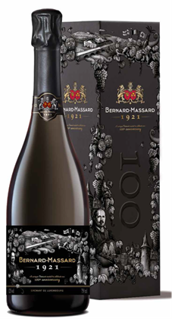
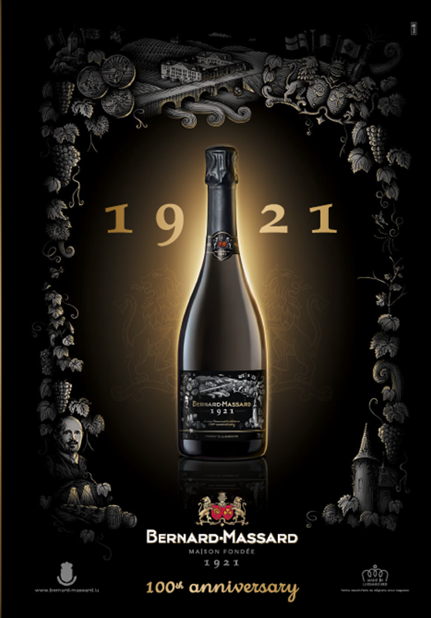
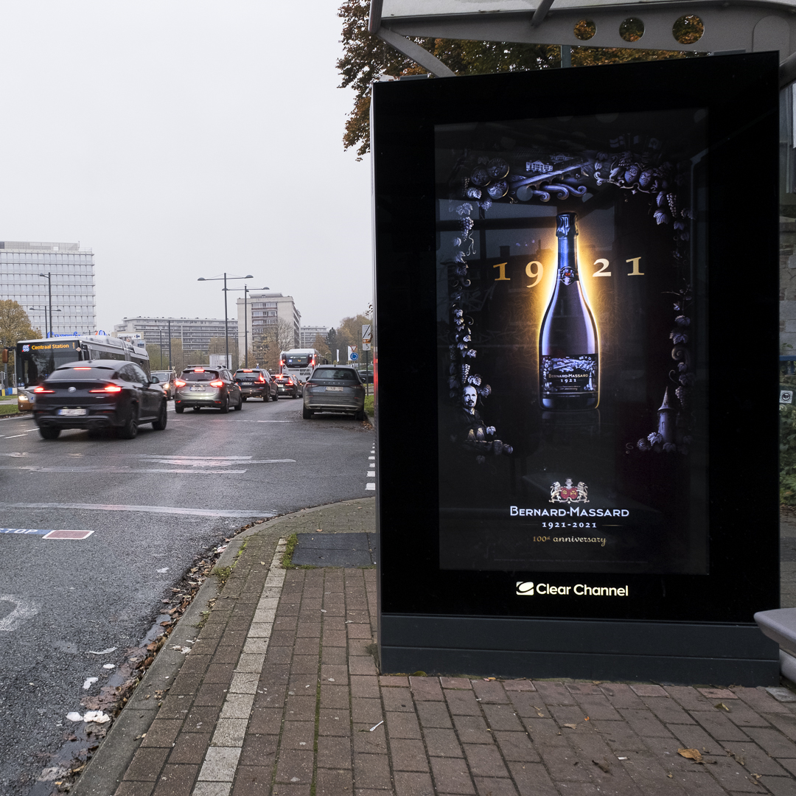
Construction of the range:
  OFF TRADE
    Cuvée SELECTION : BRUT – ROSé – DEMI SEC
    Grande Cuvée – Chardonnay
    Crémant 1921
    ORGANIC
  ON TRADE
    Cuvée ECUSSON : BRUT – ROSé
    Rosé N’Ice (beachbars – events)
    ORGANIC
    Crémant 1921
    Still wine : Clos des Rochers
One wine you want to put in the picture
  « Crémant 1921 » Crémant de Luxembourg
  100th Anniversary - Cornerstone of the range
  AOP Moselle – Crémant de Luxembourg
  Chardonnay, Pinot Noir, Riesling, Pinot Blanc, Pinot Gris
  + Cuvée ORGANIC

Slide 4

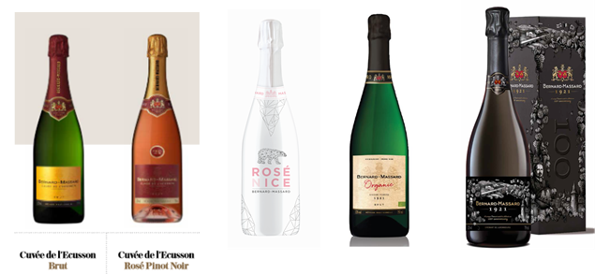
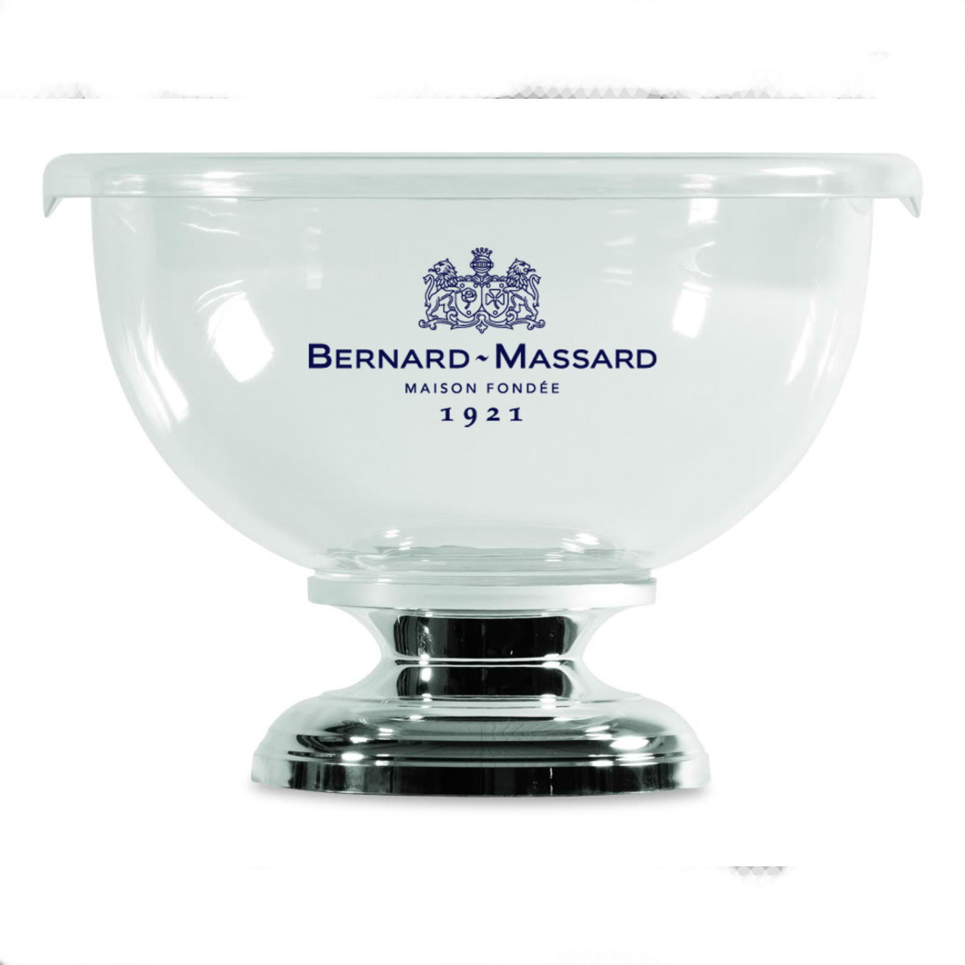
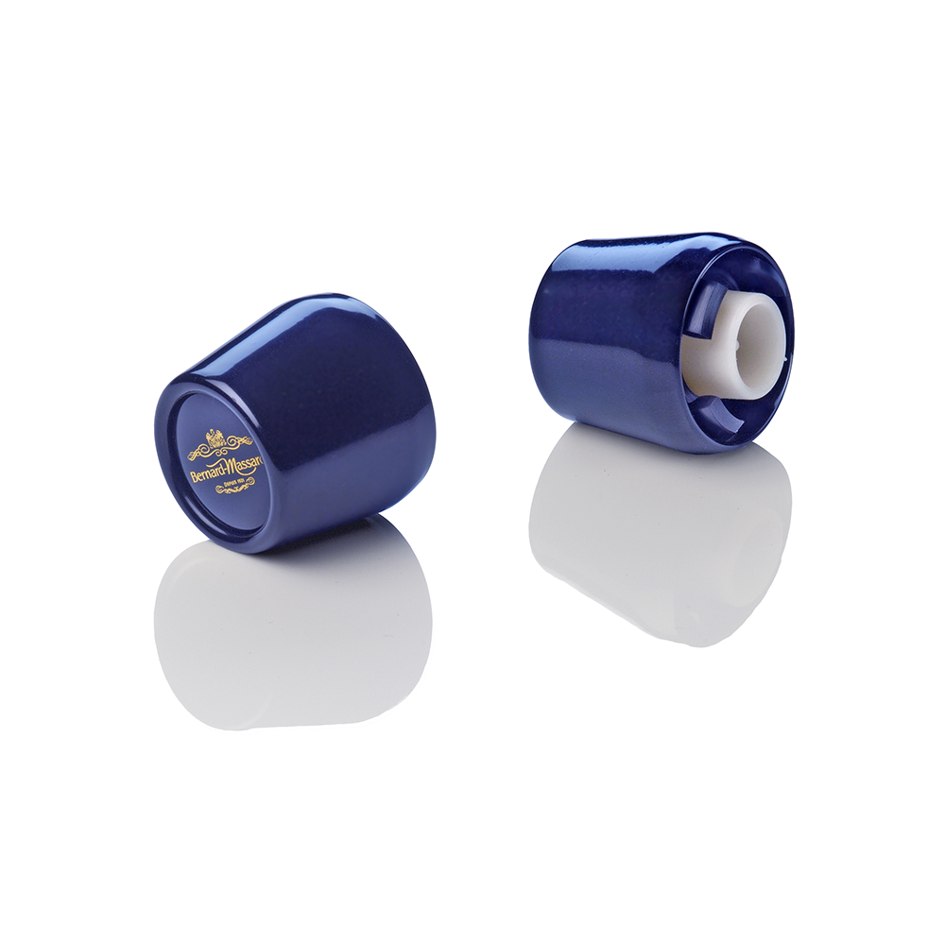
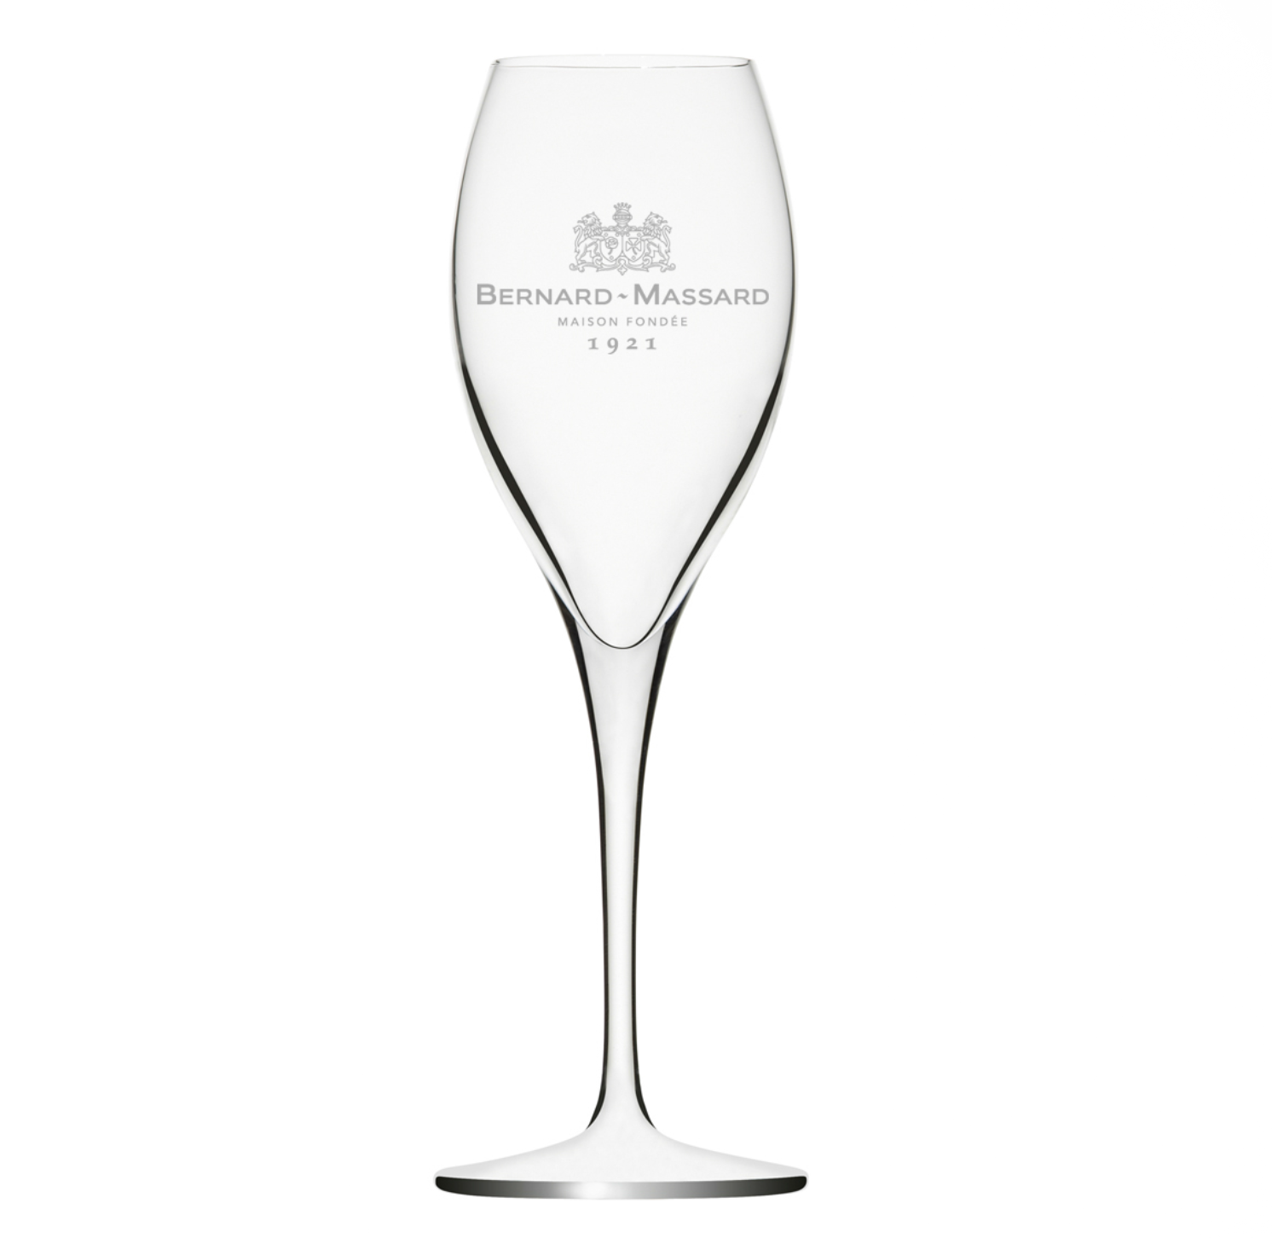
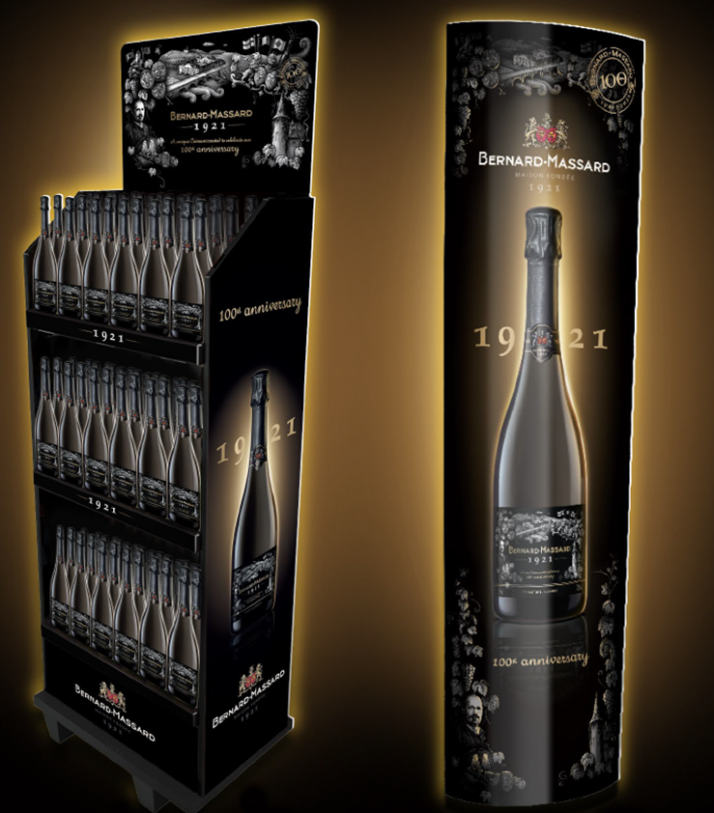
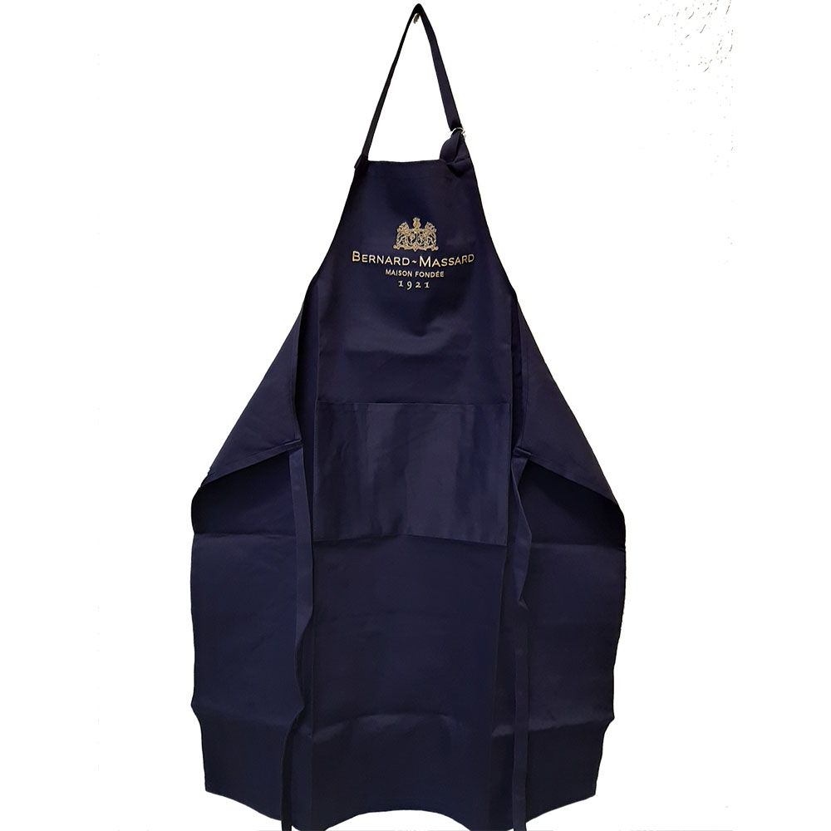
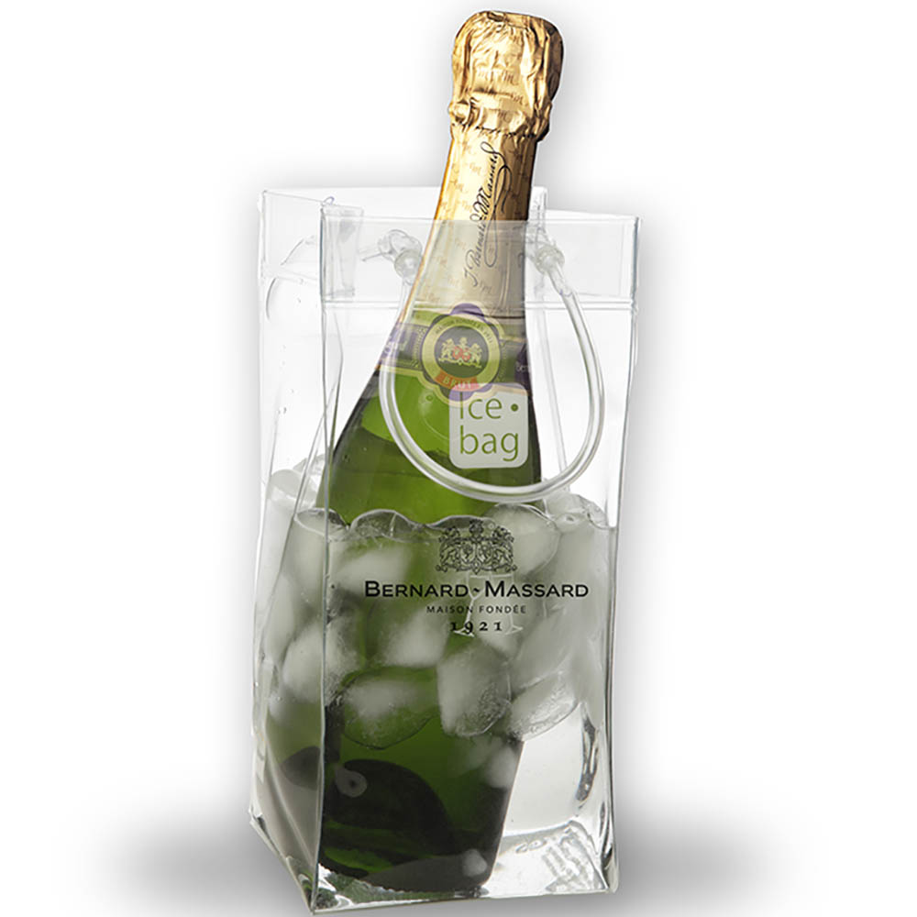
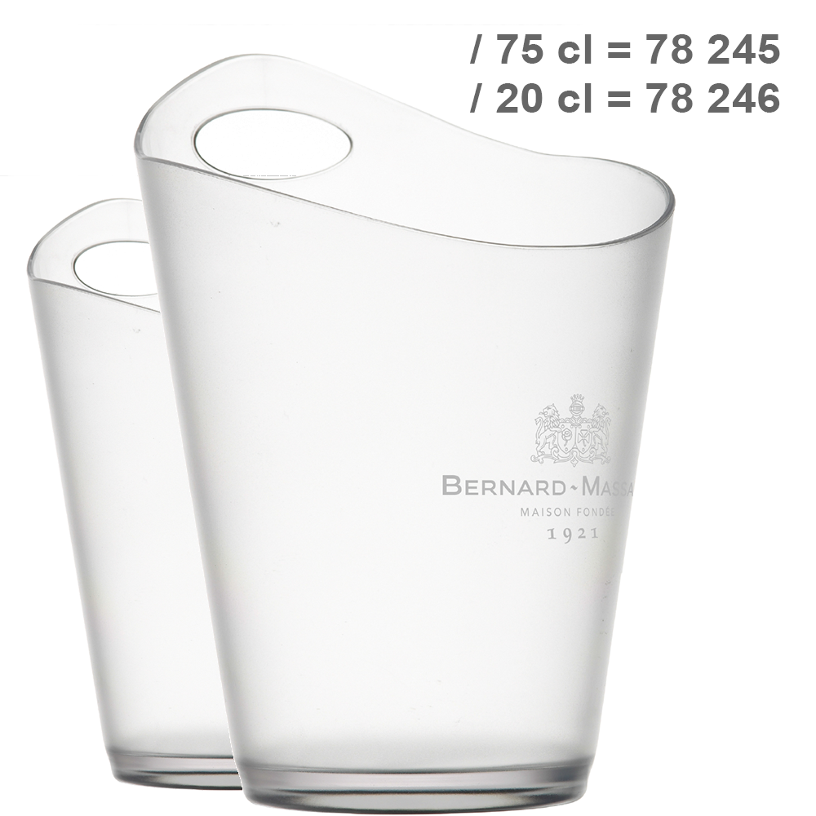

Slide 5

Pays : Luxembourg/ Gravenmacher
Société familiale
Méthode Traditionnelle
Owners : family Clasen
Founded in 1921
# Ha : 35 Ha (Moselle)
Spécificités : Premier producteur de vins effervescents Luxembourgeois
2011: Antoine Clasen joined the Group Haelterman for 2 years before joining the Family Company and becoming the General Director in 2016
Cépages blanc
  Riesling
  Pinot Gris
  Pinot Blanc
  Chardonnay
Cépages Rouge
  Pinot Noir
OFF trade
  Sélection Brut
  Sélection Rosé
  Sélection Demi Sec
  Cuvée Organic
  Crémant 1921
ON TRADE (more premium)
  Ecusson – Ecusson Rosé
  Rosé N’ice
  Cuvée Organic
  Crémant 1921

