Slide 1
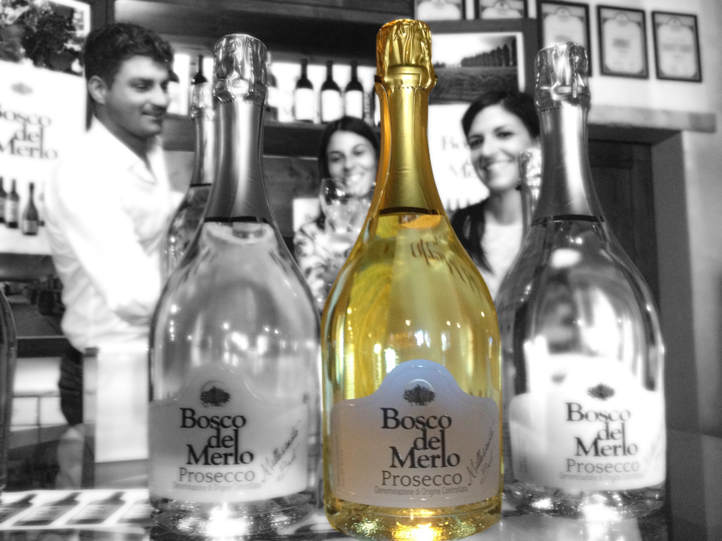
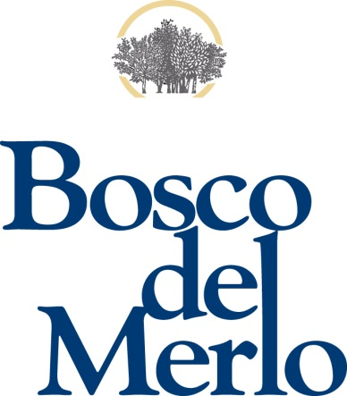

Slide 2
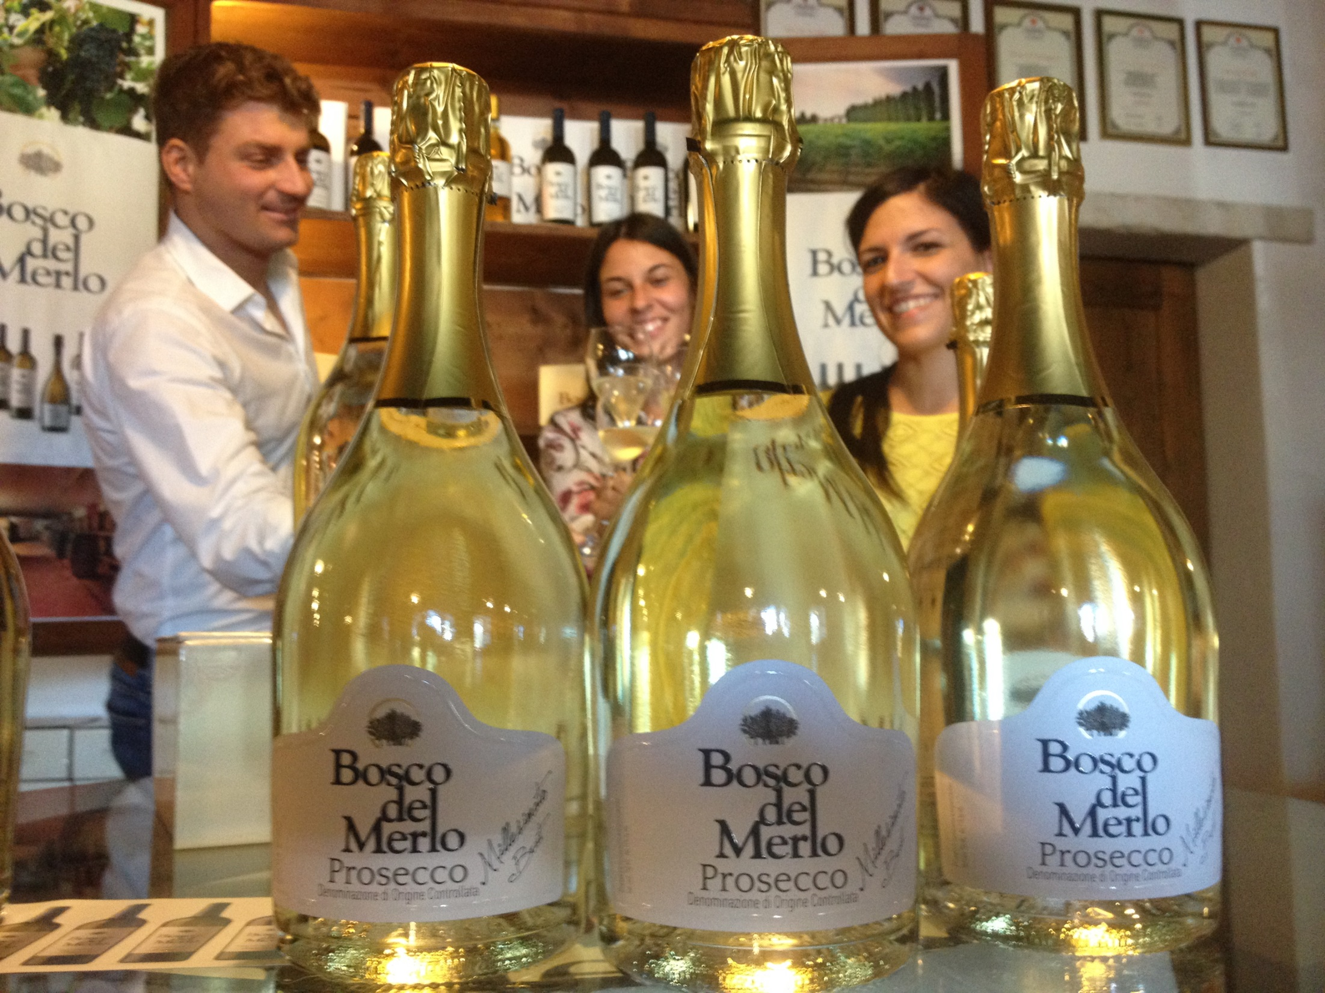
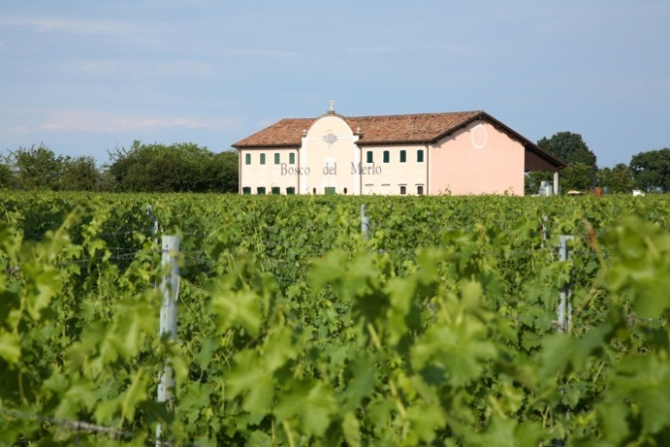
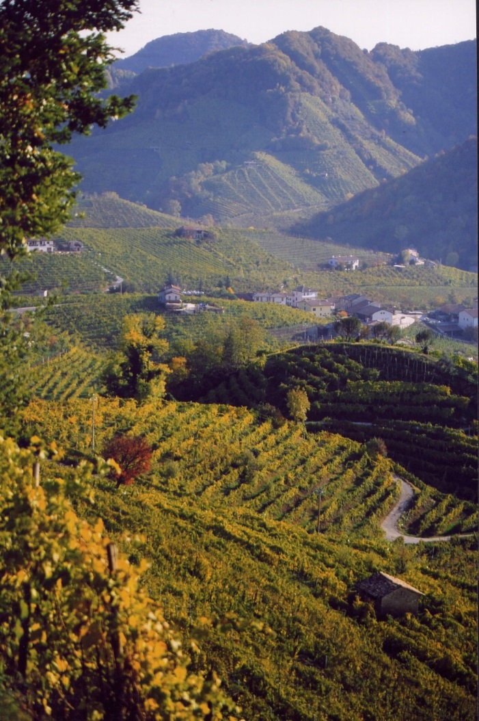
Prosecco Millesimato
DOC Brut
Bosco del Merlo-Vineyards
Valdobbiadene - Conegliano

Slide 3
Production technique
100% Glera. Obtained from grapes grown in the most typical area (Conegliano-Valdobbiadene). The Prosecco has been cultivated in this land for at least 2 centuries and according to some historians its origins date back to the Roman Empire.
The second fermentation takes place at a temperature of 16°C and produces a fine perlage, particularly pleasant and soft on the palate. This process allows the production of a delicate bouquet and charming taste.
Organoleptic characteristics
Colour: Bright straw yellow. Fine and lingering perlage.
Bouquet: Clearly fruity with hints of apple , pear and a delicate note of citrus fruit, which delicately leaves flowery hints.
Taste: Soft and elegant, with a melting of the fizziness on the palate. Tangy and lingering, pleasantly lively and light at every glass allowing for th moderate alcohol content.
Alcohol content: 11% Vol.
Serving temperature: 6/8°C
Bottle size: 750ml/1.500ml – Magum available from November 2014

Slide 4
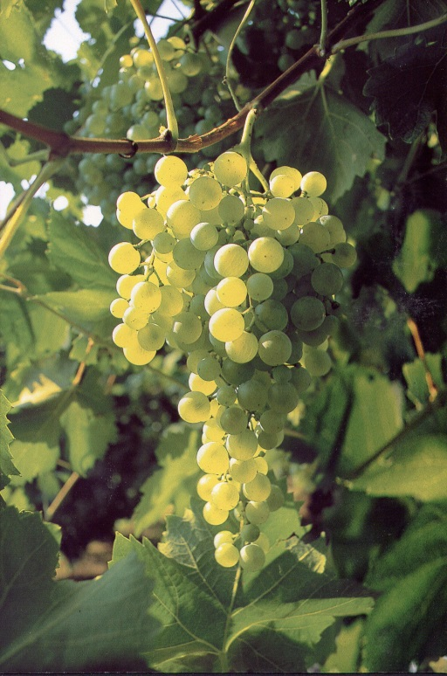
Something to know
«Millesimato» means this prosecco is made only by using different musts from the same vintage and therefore it can show the vintage in the bottle. For this reason the selection of the grapes has to be very rigorous and finalized to use only the very best grapes to produce the Millesimato.
«Brut» It is a French word that means "pure" and is used to define a sparkling wine or Champagne that has a dry taste. It is located in the lower part of the ascending scale used to indicate the sweetness, which starts with Pas Dosé, Dosage Zéro, Extra Brut (all of these bone-dry), then Brut (dry), Extra Dry (sweeter than a brut), Dry (slightly sweet) Demi-sec (quite sweet) and Dolce (definitely sweet).
Typology | Residual sugar (g/l)
Pas Dosé, Dosage Zéro | < 3
Extra Brut | < 6
Brut | < 12
Extra Dry | 12 - 17
Dry | 17 - 32
Demi-sec | 32 - 50
Dolce | > 50

Slide 5
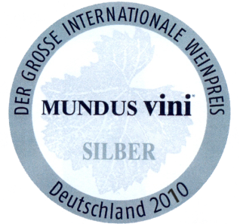
Honors and Awards
2013 → Prosecco Millesimato Brut 2012: Seal of Approval at the AWC Competition, Wien
2013 → Prosecco Millesimato Brut 2011: Silver Medal at the Internationale Schaumwein Trophy, Mallorca
Gambero Rosso
Prosecco Millesimato Brut 2010: Silver Medal at Mundus Vini 2011
2013, 2012
2013

Slide 6
Sales Arguments for PROSECCO MILLESIMATO BOSCO DEL MERLO
Sparkling Wine pleasant and fruity
Prosecco is the most beloved Veneto wine in the world
Obtained from grapes grown in the hills of Valdobbiadene-Conegliano area
Stock just in time: product is always fresh and available because bottled every 45 days
Millesimato and exist in Magnum!
The Paladin Family showed its ability to produce excellent sparkling wines, winning the “Oscar del Vino 2014” for the Best Sparkling Wine with Franciacorta Cuvée Lucrezia Etichetta Nera-Castello Bonomi, their company in Franciacorta.
Cool and unique packaging with a smart bottle .
Great as an aperitif, it is an excellent all-round wine
Quality and premium image Value, is not to be considerated like an entrance level prosecco !
Great wine for VIP celebrations and unforgettable toast
Product dedicated exclusively to restaurants and wine bars all over the world. Found in the best hotels and restaurants around the world, such as: - “5-Star Hotel Danieli” Venice - “5-Star Baur au Lac” Zürich - “5-Star Hotel Ronacher” Austria - …
www.boscodelmerlo.it

Slide 7
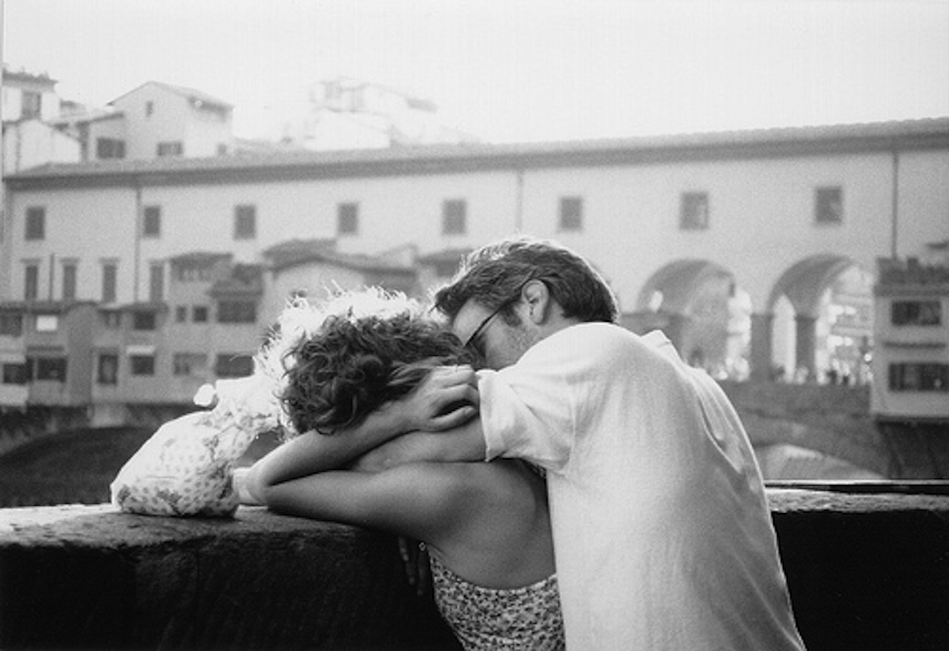
Classy and italian !

