Slide 1
&

Slide 2
Great Results in 2015 Competitions & 2016 Guides for Paladin and Bosco del Merlo Wines!!!

Slide 4
Pinot Grigio PALADIN DOC 0
3 Grapes
Bibenda Guide

Slide 5
Syrah PALADIN
4 Grapes
Bibenda Guide
3 T
Guida Ais Vitae
Gold Medal
At Concours Mondial de Bruxelles

Slide 6
Malbech Gli Aceri PALADIN
2 Glasses
Gambero Rosso Guide
89 Points
Veronelli Guide
4 Grapes
Bibenda Guide
3 T
Ais Vitae

Slide 8
Prosecco Millesimato Brut D.O.C.
1 Glass
Gambero Rosso Guide
3 Grapes
Bibenda Guide

Slide 9
Sauvignon Blanc «Turranio» D.O.C.
2 Glasses
Gambero Rosso Guide
3 Grapes
Bibenda Guide
3 T
Ais Vitae

Slide 10
Merlot «Campo Camino» D.O.C.
1 Glass
Gambero Rosso Guide
88 points
Veronelli Guide
3 Grapes
Bibenda Guide
3 T
Ais Vitae

Slide 11
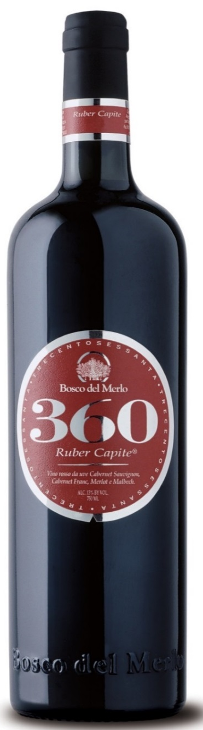
360 Ruber Capite
2 Red Glasses
Gambero Rosso Guide
90 Points
Veronelli Guide
4 Grapes
Bibenda Guide

Slide 12
&

