Slide 1
VERDICCHIO CASTELLI DI JESI CLASSICO
« TITULUS »

Slide 2
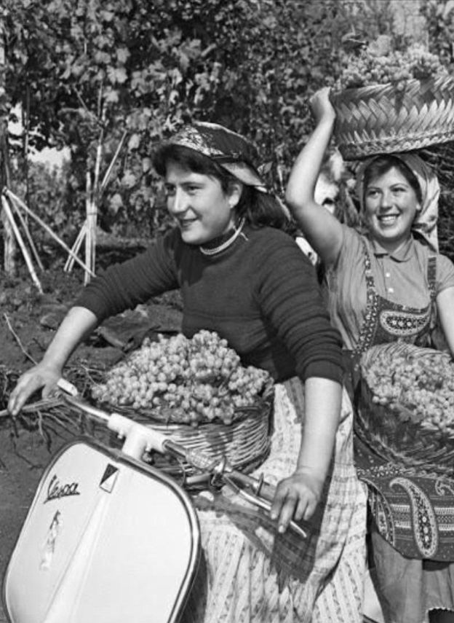
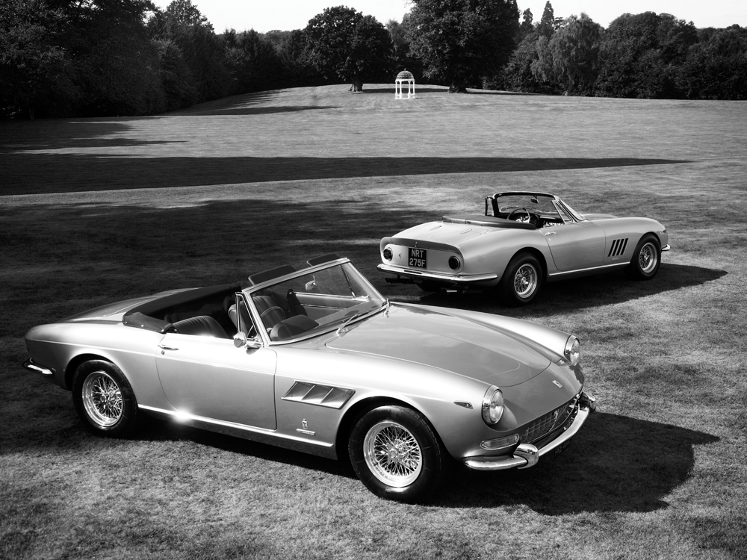
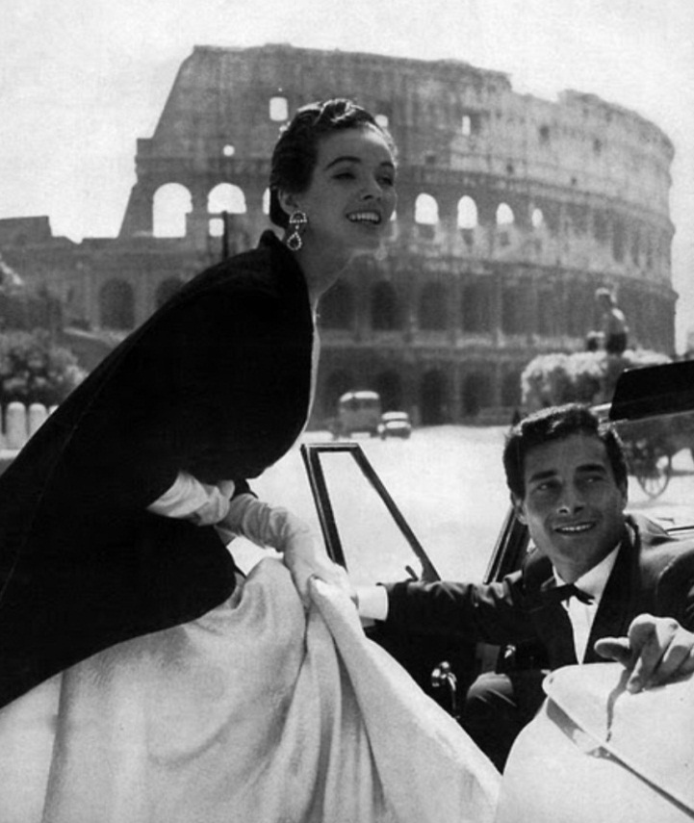
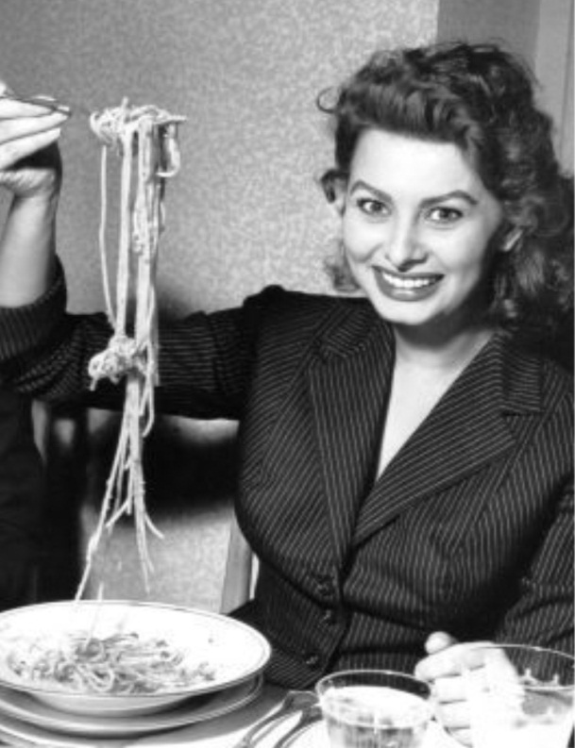
OUR SPIRIT
FAZI BATTAGLIA is one of the great 1950s and 60s Italian brands with an ideal of a…
HARDWORKING
CONSTRUCTIVE
STYLISH
AUTHENTIC

Slide 3
AN ITALIAN WINE ICON
FAZI BATTAGLIA is:
a centre stage player of these Italian golden years.
VERDICCHIO's official mother, a wine whose history is interwoven with Italy's.
a desire to (re)establish its identity and reappropriate its leading role in Italy, under the guidance of BERTANI DOMAINS, and take its place in the Italian wine salon as Verdicchio's ambassador and spokesperson.

Slide 4
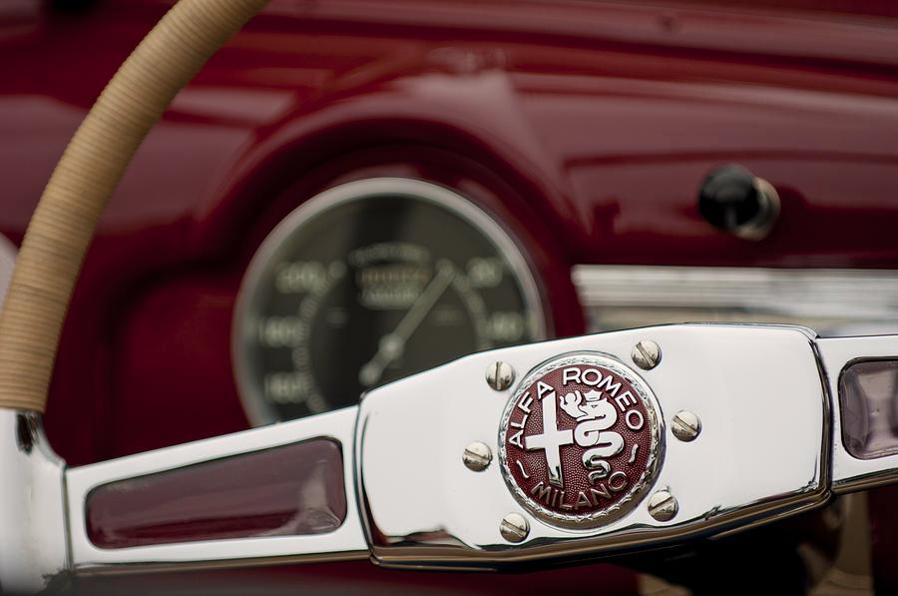
RE-LAUNCHING A LEGEND
RE-LAUNCHING THE GREAT LEGENDS OF THE PAST IS FASHIONABLE THESE DAYS.
And thus there is nothing accidental about the fact that Alfa Romeo revved up the engines of its Giulia on the 24th of June, bringing the iconic star of 1970s crime thrillers back to life.

Slide 5
OUR PHILOSOPHY
FAZI BATTAGLIA is fully committed to BERTANI DOMAINS' philosophy, values and style:
Strong brand identity, market leader.
Integrity, honesty and transparency.
Research and innovation, exploring new production methods but remaining tied to its traditions at all times.
Respect and commitment to true values.

Slide 6
MISSION
with its 130 hectares of Verdicchio dei Castelli di Jesi Classico, it represents Marche wine’s tradition and history internationally.
born in the 1940s, it has become symbol of Verdicchio and Italian wine, thanks to the historic amphora bottle created in 1953.
its search for quality excellence, involving selecting vineyards in the most suitable areas and with ongoing research and experimentation both in the vineyards and in the wine cellars, has historic and solid roots.
FAZI BATTAGLIA is fully committed to BERTANI DOMAINS' mission because:

Slide 7
COMMUNICATION

Slide 8
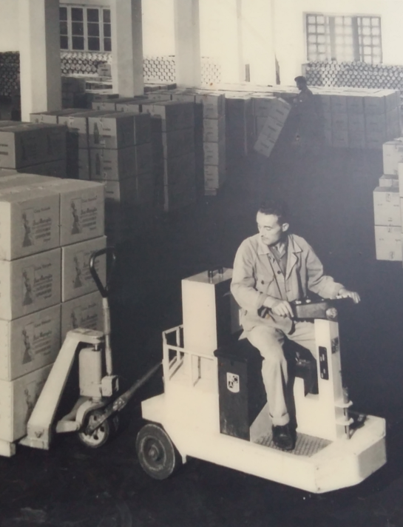
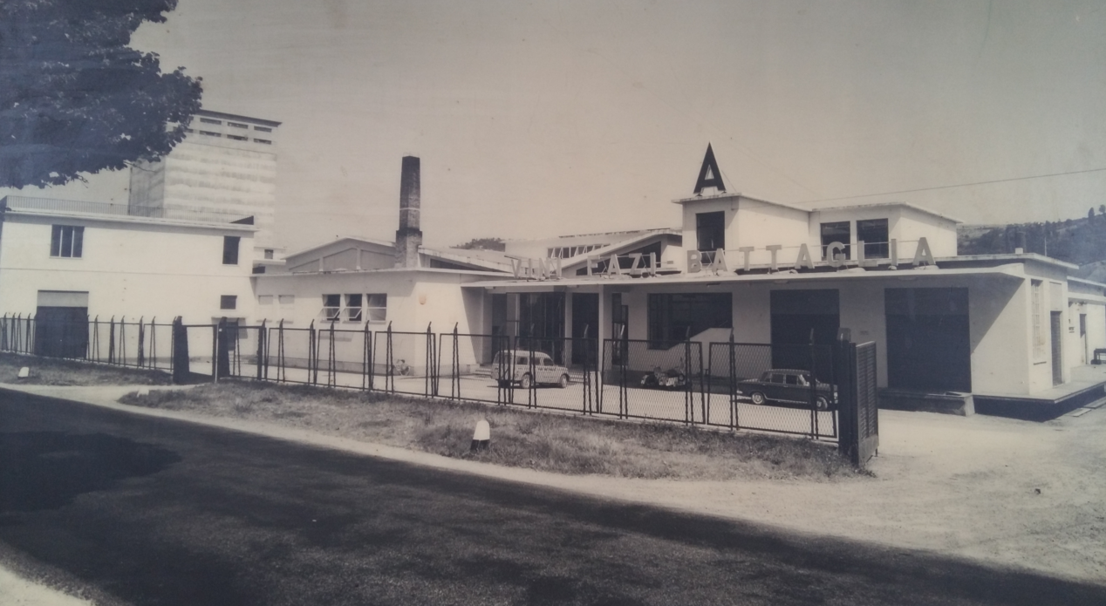
BRAND
FAZI BATTAGLIA, A GREAT ITALIAN BRAND
Most companies and brands have strong bonds with the areas they were created in. There are, however, very few production companies whose names are emblematic to the nation they evoke in a wider sense. Fazi Battaglia belongs to this latter group. It is its history which makes the difference. Ours is a name which is an indissoluble part of Italy's history and image. This, first and foremost, is Fazi Battaglia. For seventy years, a name which has not simply been emblematic of great wines, but also of Italian style, a way of being, a lifestyle which has made us popular the world over. And if 'Made in Italy' has great meaning today, it is also thanks to companies like Fazi Battaglia, for whom tradition has never been distinct from creativity and the courage to dare, to innovate.

Slide 9
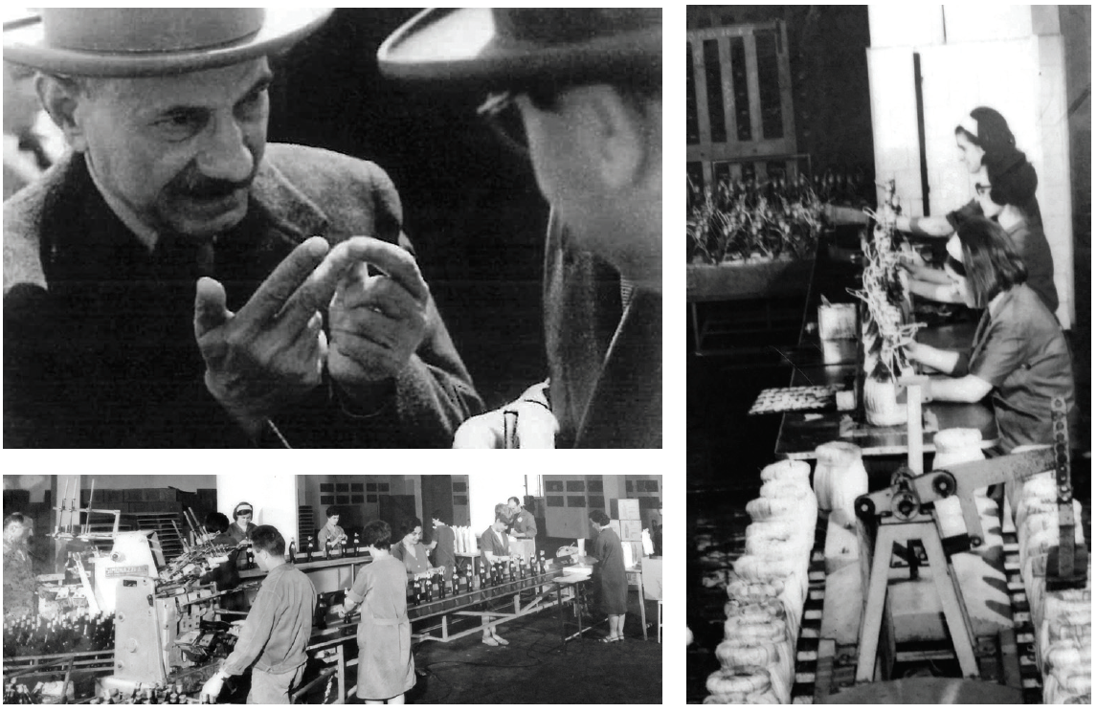
HISTORY
COURAGE AND INNOVATION
Fazi Battaglia was set up in 1949 when two families - Fazi and Battaglia - joined forces in a small wine estate in the town of Cupramontana, but it was the Angelini family just a few years later which made the company into a historic Italian wine making brand. And all this thanks to courage and an intuition which can be summed up in two fundamental and decidedly innovative choices for the era: investing strongly in vineyard improvment (in an era in which quality considerations were still a very long way from being central to Italian winemaking) and, at the same time, a strong belief in a single vine, Verdicchio. Two choices which were ahead of their time and made Fazi Battaglia a standard bearer for the promotion of production areas like the Marche region and one of the great native Italian vines.

Slide 10
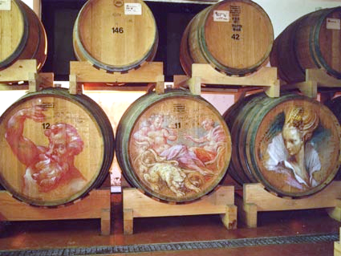
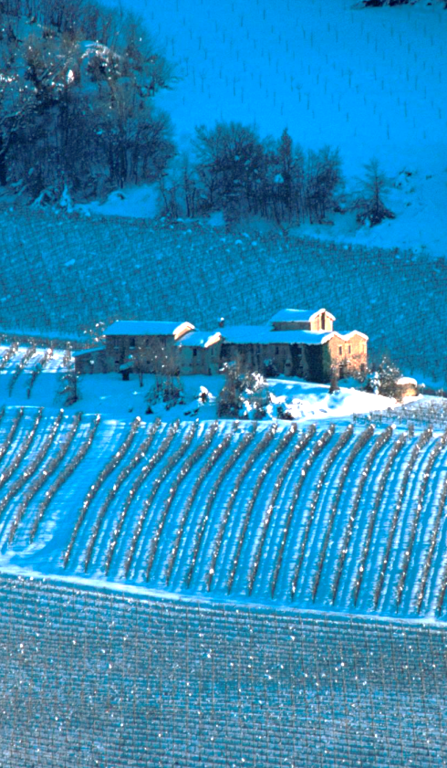
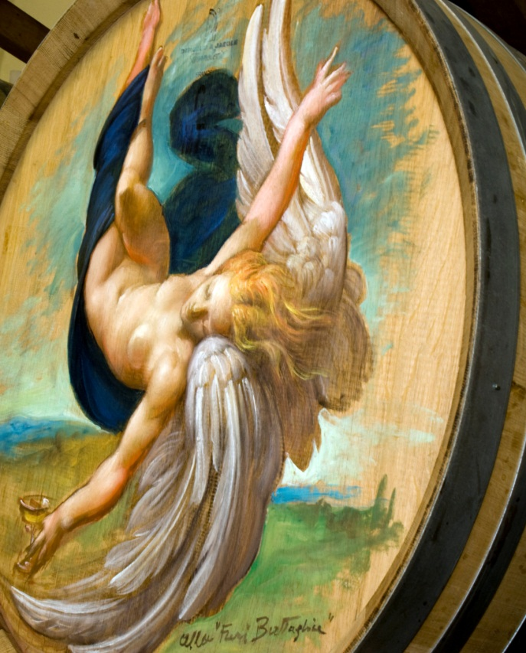
TODAY
A RENEWED RESPONSIBILITY
The Angelini family is returning to Fazi Battaglia today, not simply to continue the quality and innovative journey started in the 1950s, but also to take up the gauntlet of great representative of Italy's authentic winemaking identity once again. It is an overt responsibility, which is fully in line with the Bertani Domains production philosophy. The Bertani Domains group is owned by Angelini and encompasses some of the best names in Italian winemaking (Bertani, Puiatti, Val di Suga, Tre Rose, San Leonino), all companies which focus on respect for terroir and exalting the identity of native grape varieties. And all this in the name of transparency and rigorous production methods.

Slide 11
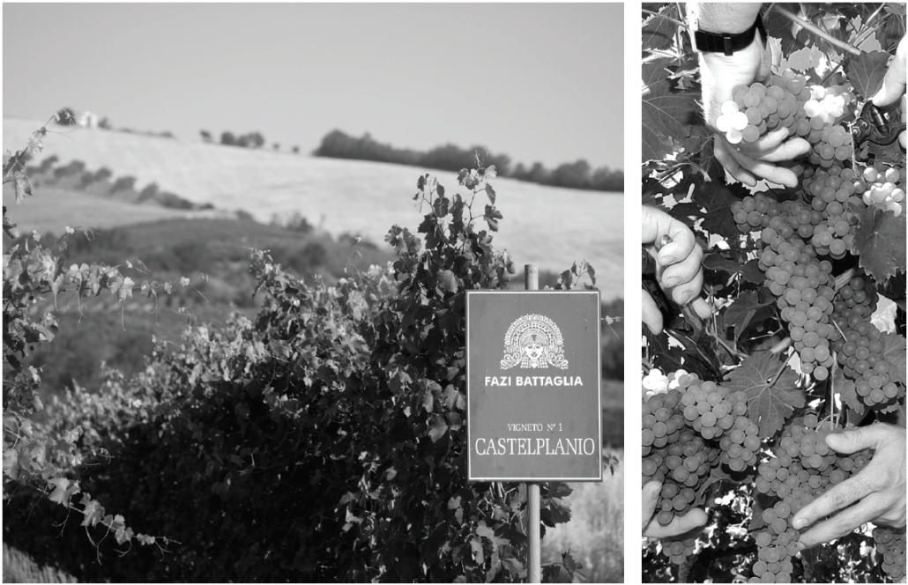
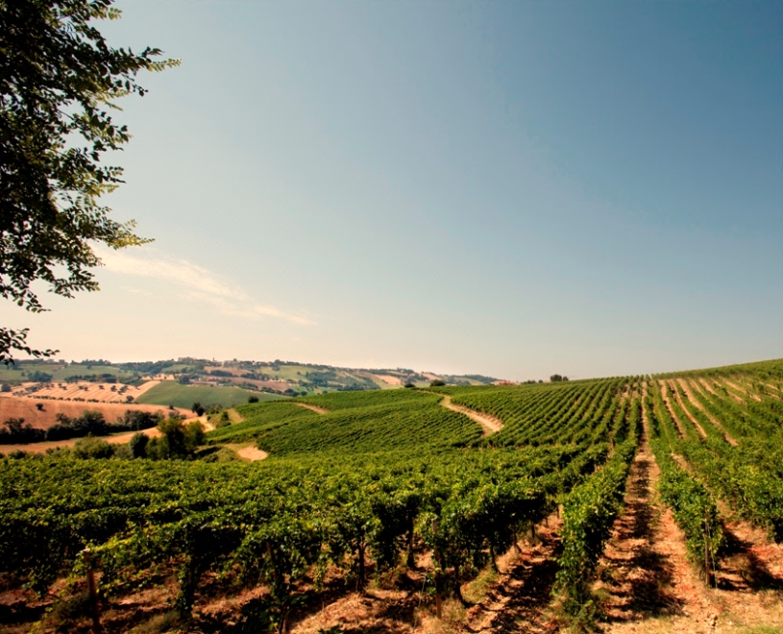
VINE
FAZI BATTAGLIA, HISTORIC VERDICCHIO SYNONYM
Fazi Battaglia's history is proof of the fact that you can achieve greatness from apparently small things. In this case the 'small thing' in question is Verdicchio, the grape variety on which Fazi Battaglia's whole history has been built. It is a unique case in Italy. Seventy years of total focus on a single grape variety, which has found the ideal terroir to bring out its individuality in the beautiful hills of Castelli di Jesi. One hundred and thirty hectares dedicated to passion and attention to Verdicchio. Vineyards with varying soils, altitude and sun exposure, capable of ensuring the most diverse incarnations of one of Italy's most eclectic native grape varieties.

Slide 12
Verdicchio Fazi Battaglia, a question of styles

Slide 13
VERDICCHIO
... A RANGE OF AROMAS
THIOLS
METHOXYPYRAZINES
TERPENES
HYDROCARBONS
NORISOPRENOIDS
CITRUS
SPICES
SAUVIGNON
RIESLING
CHARDONNAY
1
2
3

Slide 14
RANGE OF STYLE
1
2
3
CRISP SEASIDE
MATURE ROUNDED
ELEGANT LONG-LIVED
WISTERIA
ELDERFLOWER ANISE
TROPICAL FRUIT
SAVORY / FRESH
GOLDEN APPLE
STEWED PEAR
ANISE
HYDROCARBONS
ROUNDED / MINERAL
CITRUS
VANILLA
LIQUORICE / CHOCOLATE
MEDITERRANEAN
STRUCTURED
STYLE
NOSE
MOUTH

Slide 15
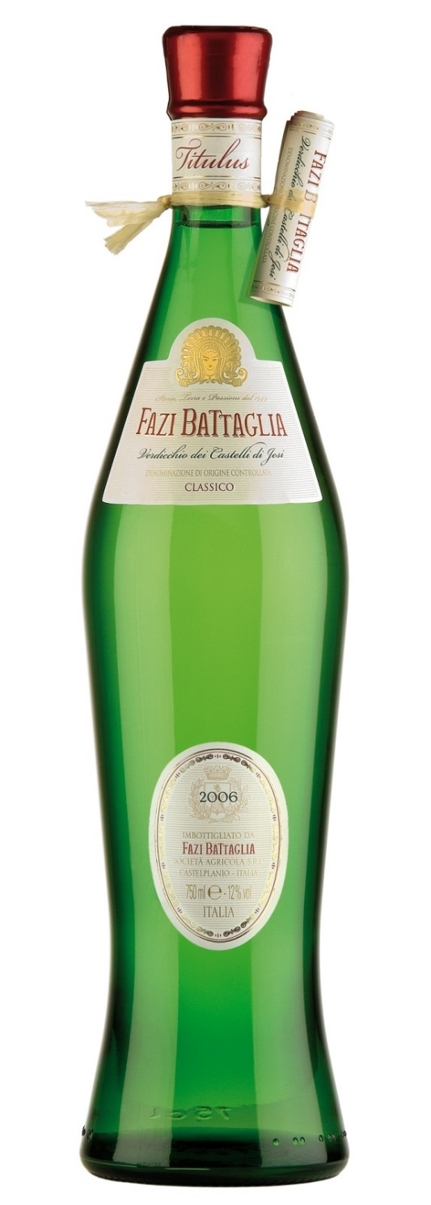
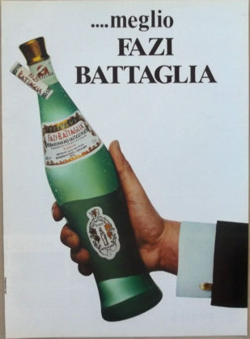
ANFORA / TITULUS

Slide 16
ANFORA TITULUS
A new arrival with the 2015 harvest.
A new arrival with the 2015 harvest.
Very few bottles in the world are as indissolubly bound to the wine they contain as the emerald green Verdicchio dei Castelli di Jesi Anfora Titulus.
This is the idea behind enhancing the identity of this wine with a new product, aimed at returning to its former glory not simply the most famous Verdicchio in the world, but also an icon of Italian style.

Slide 17
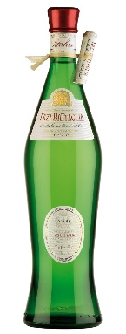
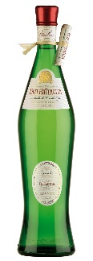
TITULUS
Verdicchio dei Castelli di Jesi
D.O.C. Classico
Packaged in the unique
emerald green amphora
shaped bottle, Titulus remains
Fazi Battaglia’s icon…
The winery dedicates particular attention in
order to guarantee a product with enviable
qualitative continuity, regardless of its production
size. The grapes are grown in the 300 hectares of
estate-vineyards, subdivided into 12 distinct
single-vineyards of different exposition.
GRAPE VARIETY:
100% Verdicchio
Produced in the classic area of the Verdicchio dei Castelli di Jesi, Verdicchio’s Titulus comes exclusively from grapes selected and harvested by hand throughout Fazi Battaglia’s vineyards: 300 acres nestled in the heart of the hills at altitudes and exposures that are different and complementary. The grapes are carefully selected by hand during a 20-25 days harvest in Estate vineyards. Each of the 12 single vineyards is studied for the optimal harvesting moment.
PRODUCTION TECHNIQUE:
The grapes are softly pressed and fermented in temperature controlled stainless steel vats for 15-18 days. Then, the wine is left to rest for several months in temperature controlled stainless steel vats to produce complexity on the palate and ripeness on the nose. A 30-days bottle rest follows.
TASTING CHARACTERISTICS:
Colour: pale straw with jaded hues during the first months.
Bouquet: intense bouquet of peach, apple, roses, characteristic of the noble
Verdicchio grape.
Taste: refreshing, sapid with a pleasant bitter almond finish.
Serving Temperature 12°C
375 cl 750 cl 1500 cl

