Slide 1
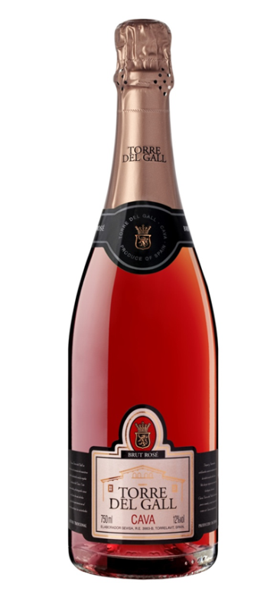
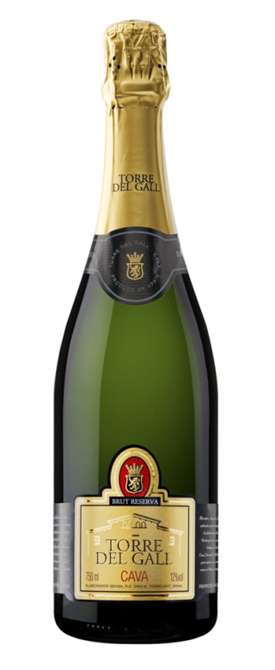
Cellar acquire in 2003 from French Moët & Chandon Cellar
Reserva style, suited to the HORECA market
Single State winery
Own yeast- no commercial
Total family ownership – long term investment, plan and vision
Boutique but with good volumes
Excellent image/labels/packaging
Great location:
Quality vineyard areas
Easy for visits – close to Barcelona!
Meeting area for use with customers

Slide 2
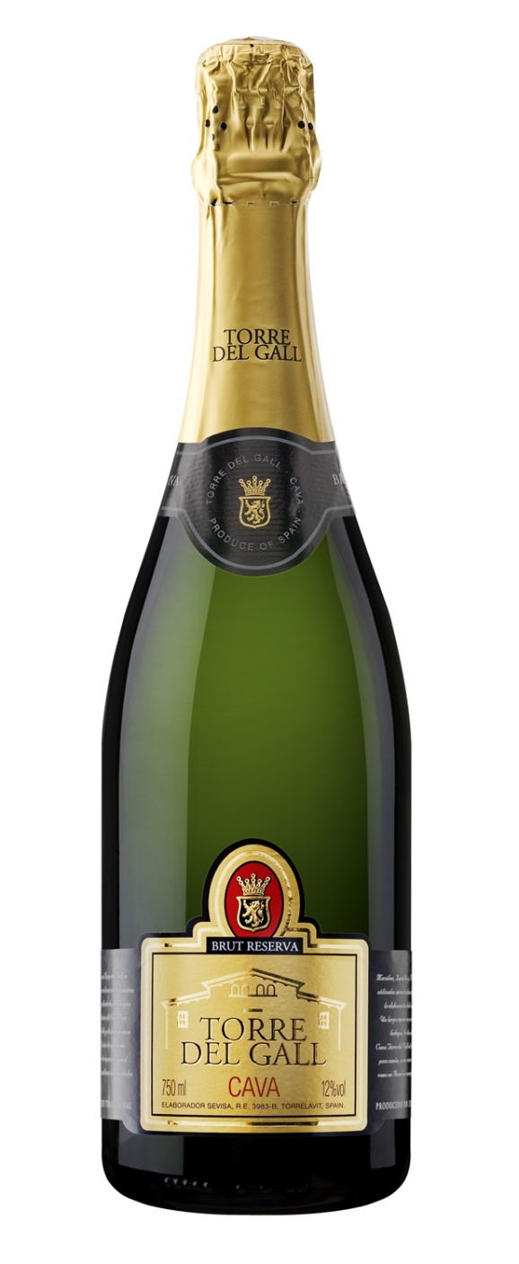
Brut DO CAVA
Coupage
The Brut Cava has been selected by us to represent the quality and value Cava can offer, with a fantastic blend of Macabeo (50%), Xarel.lo (15%) and Parellada (35%).
Tasting note
This is a high quality cava for its optimal degree of ageing, and the balance achieved between acidity and body. The colour is a pale straw yellow, with a fine and persistent bubble. On the nose is bright and elegant, with a harmonious. The palate is balanced and refreshing; the sparkle is lively, mouthllinf and exciting. There are notes of ample avour as a obvious predominance of Macabeo.
Ageing
The wine is aged between 18 and 24 months on their skins prior for maximum richness and complexity.
AnalysisAlcohol:11,5% vol.
Dosage:9 g/l
Suggested food
Appetisers, fish soup, white fish, sea food, stuffed squid and cold cuts.
Ideal seving conditions
Serve between 8 and 10 ºC.

Slide 3
Rose DO CAVA
Coupage
The Rosado has been selected by us to represent the quality and value Cava can oer, with a fantastic blend of Trepat( 80%) and Garnacha (20%).
Tasting note
Bright strawberry pink, with an abundant mid sized bubble, which forms a good crown at the top of the glass. The nose is wonderfully fruity which resembles raspberries, currants and grenades. The palate is with good presence of fruits (crystallized cherry). It is delicate and has a sweet touch that spreads evenly in the aftertaste.
Ageing
The wine is aged between 12 and 18 months on their skins prior for maximum richness and complexity
AnalysisAlcohol:12% vol.
Dosage:9 g/l
Suggested food
Appetisers, vegetables, pastas, rice dishes, cocktails
Ideal seving conditions
Serve between 6-8ºC.

