Slide 1
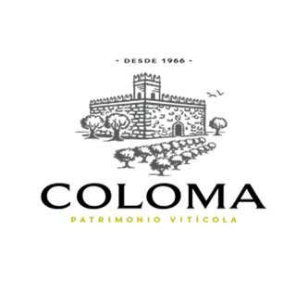
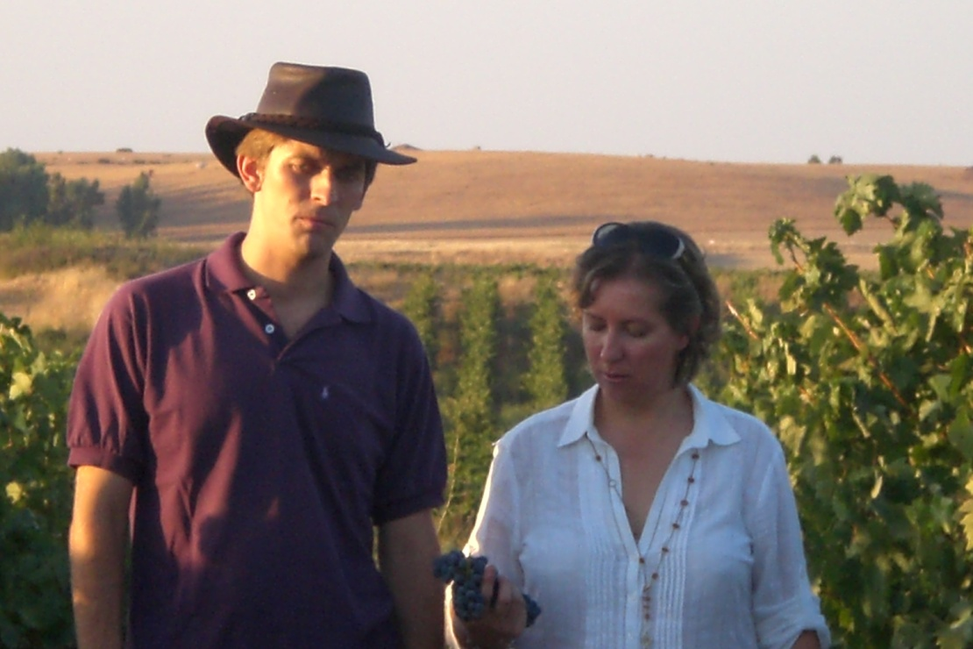
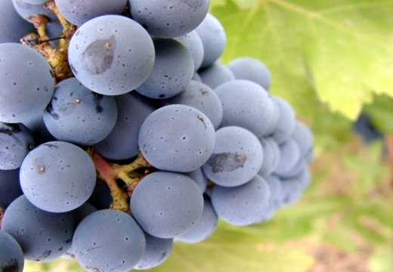
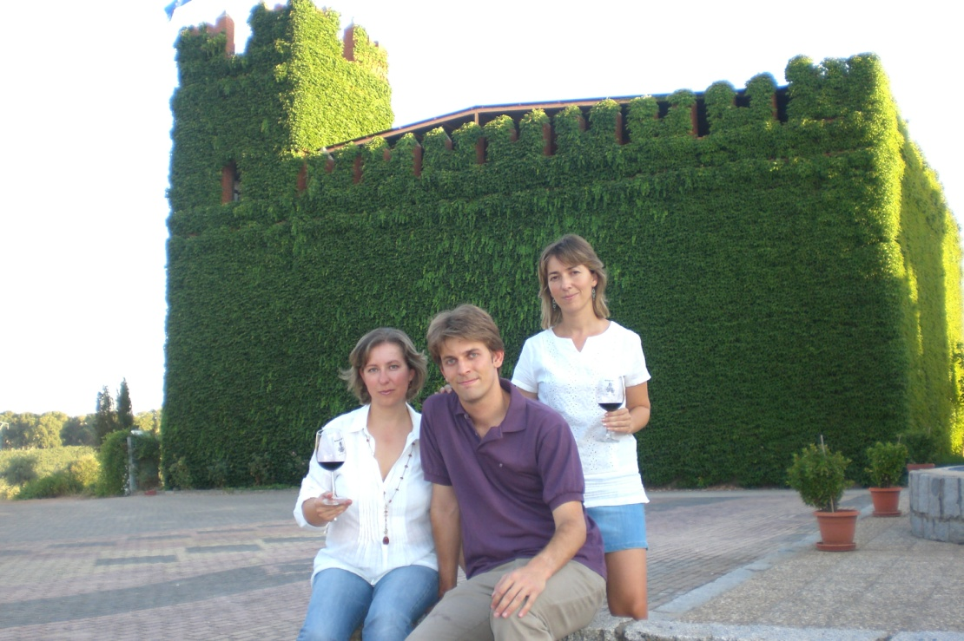
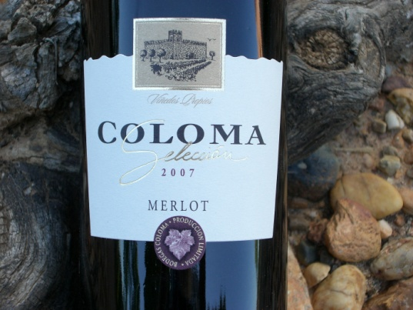
Vineyards and winery since 1966
Wines with soul and soil from the heart of Spain Extremadura

Slide 2

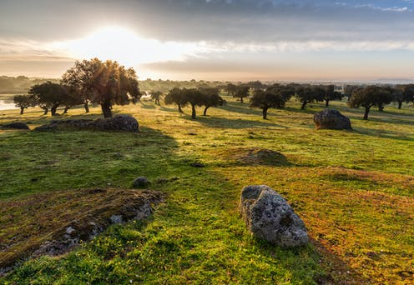
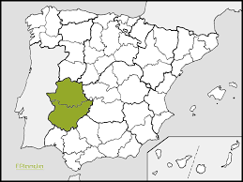
OUR LOCATION: EXTREMADURA
The iberian paradise
Located in Extremadura, south-western Spain, we are in a bountiful land with a great wealth of environmental resources and gastronomical richness such as Iberico meat.
Fertile lands, with a mean average temperature of 17C, 400-600 mm3 of annual rain accumulation and plentiful, generous sunshine all year round allow us to be the natural food basket of Spain and Europe.
Our vineyard lies on the “RAYA” the stripe area that defines one of the oldest borders in the world.
Nevertheless, “Lusitanian vineyards” do not know about borders. They grow on both sides of Guadiana, a river that separates them and at the same time joins them together to form a single region.
In Extremadura’s extreme continental weather – sun-drenched days, and cool, acid-preserving nights are the norm. The overall stress in the vines provides for endless structure and power.

Slide 3
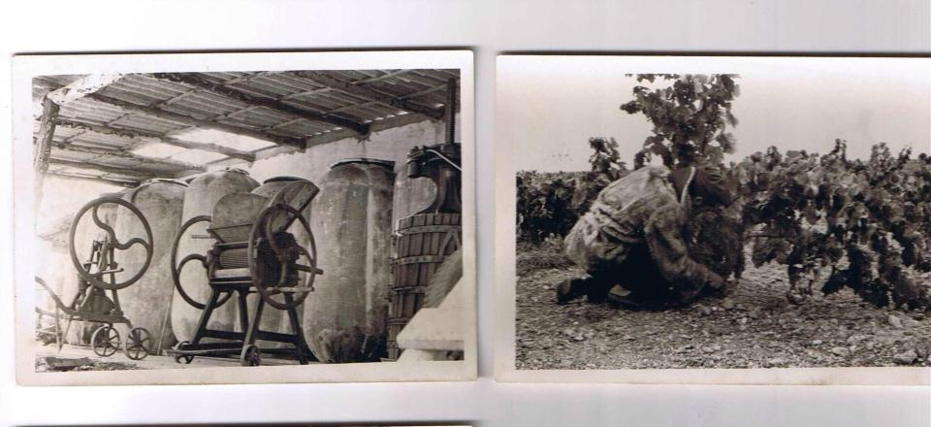
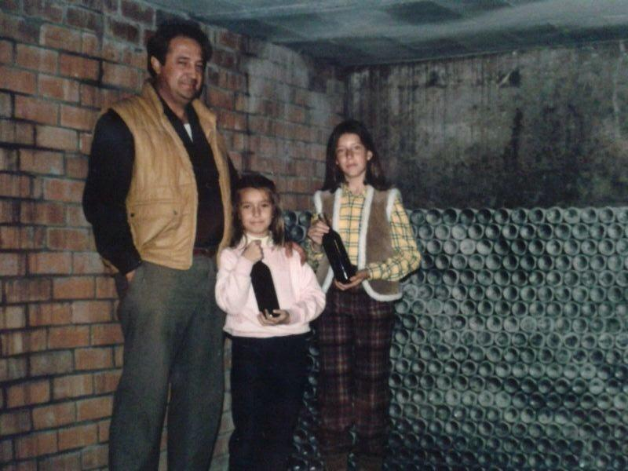
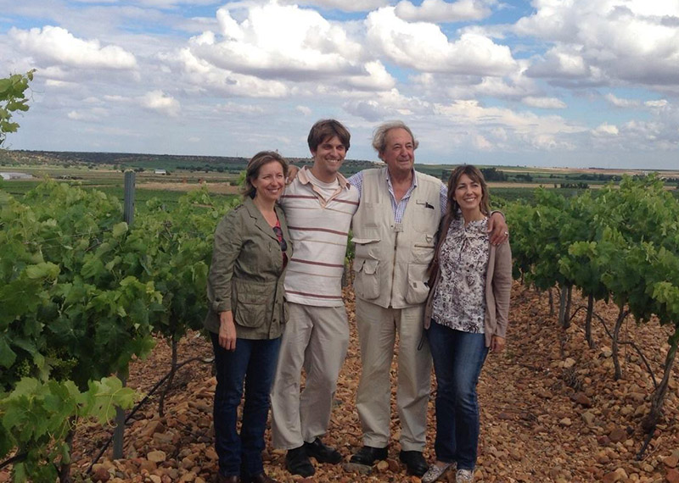
FAMILY TRADITION
The winemaking tradition of the Coloma family began at the end of the 19th century when Don Francisco Coloma started making home-made wines for the local market of his native town, Villanueva de los Infantes Valladolid, Spain.
Years later, one of his grandsons, José Félix, seeking a warmer weather, decided to continue the winemaking tradition down in Extremadura.
It was in Alvarado, along the river-banks of the Guadiana river, where he planted the first vines. Taking advantage of this gentle climate, José Félix Coloma has been growing Spanish and international varieties since 1966.
Notes:
A vineyard and a family

Slide 4
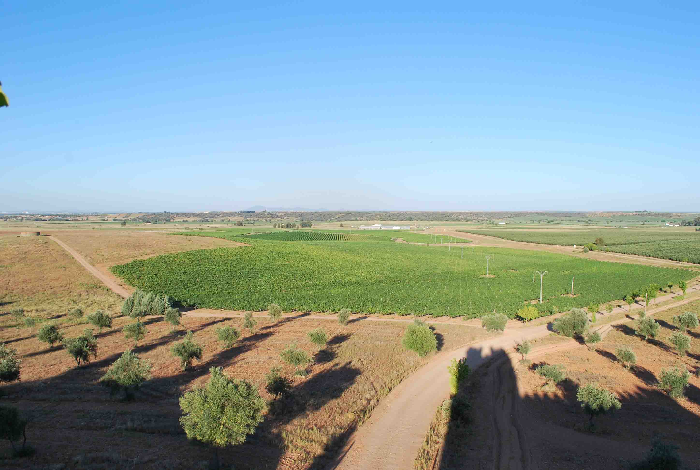
VINEYARDS
Wines are exclusively made with our own grapes coming from 55 hectares of vineyard located around the cellar castle.
Sustainable vinegrowing
Singular soil
Local Varieties: Garnacha Tintorera, Alarije, Graciano, Touriga Nacional.
International Varietals: Merlot, Pinot Noir, Muscat, Cabernet Sauvignon

Slide 5
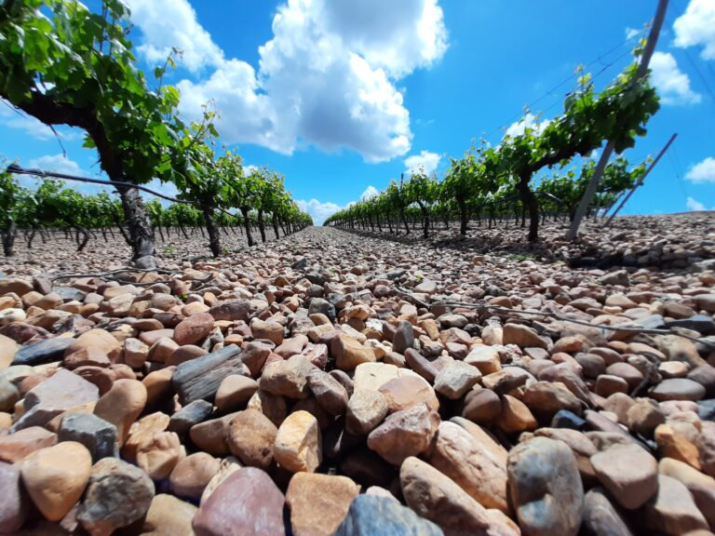
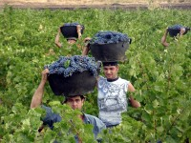
VINEYARDS
Wines exclusively made with our own grapes coming from 55 hectares of vineyard located around the cellar castle.
Sustainable vinegrowing
Singular soil
Local Varieties: Garnacha Tintorera, Alarije, Monastrell, Graciano
International Varietals: Merlot, Pinot Noir, Syrah and Cabernet Sauvignon

Slide 6
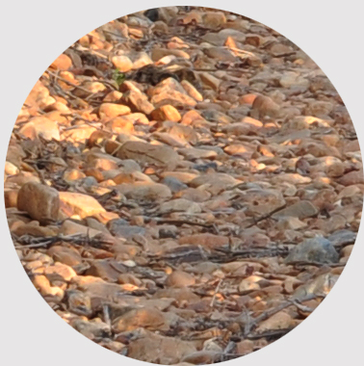
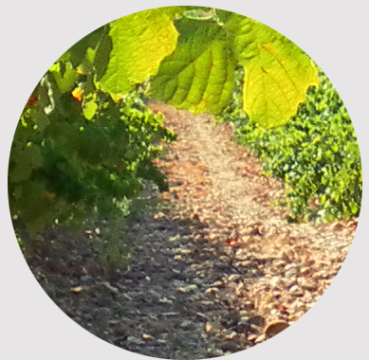
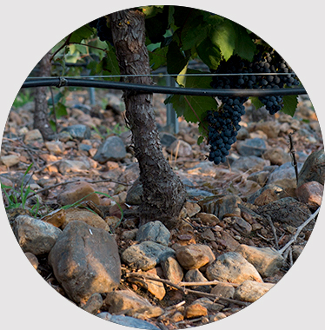
River rock and pebblestone
The peculiarity of our soil
The soil where Coloma vineyard stands used to be a lake, therefore rocks and stones are predominant. These stones and rocks have been shaped along the years by the river Guadiana creating round pebbles.
On stony and well-drained soil, the grapes grown on this vineyard develop high quality and reach great potential, giving rise to wines that exhibit an exceptional personality and style.
Stones also help to maintain ground humidity during the dry, hot Summer months.

Slide 7
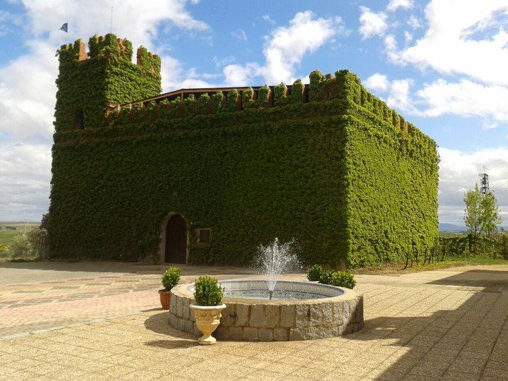

Slide 8
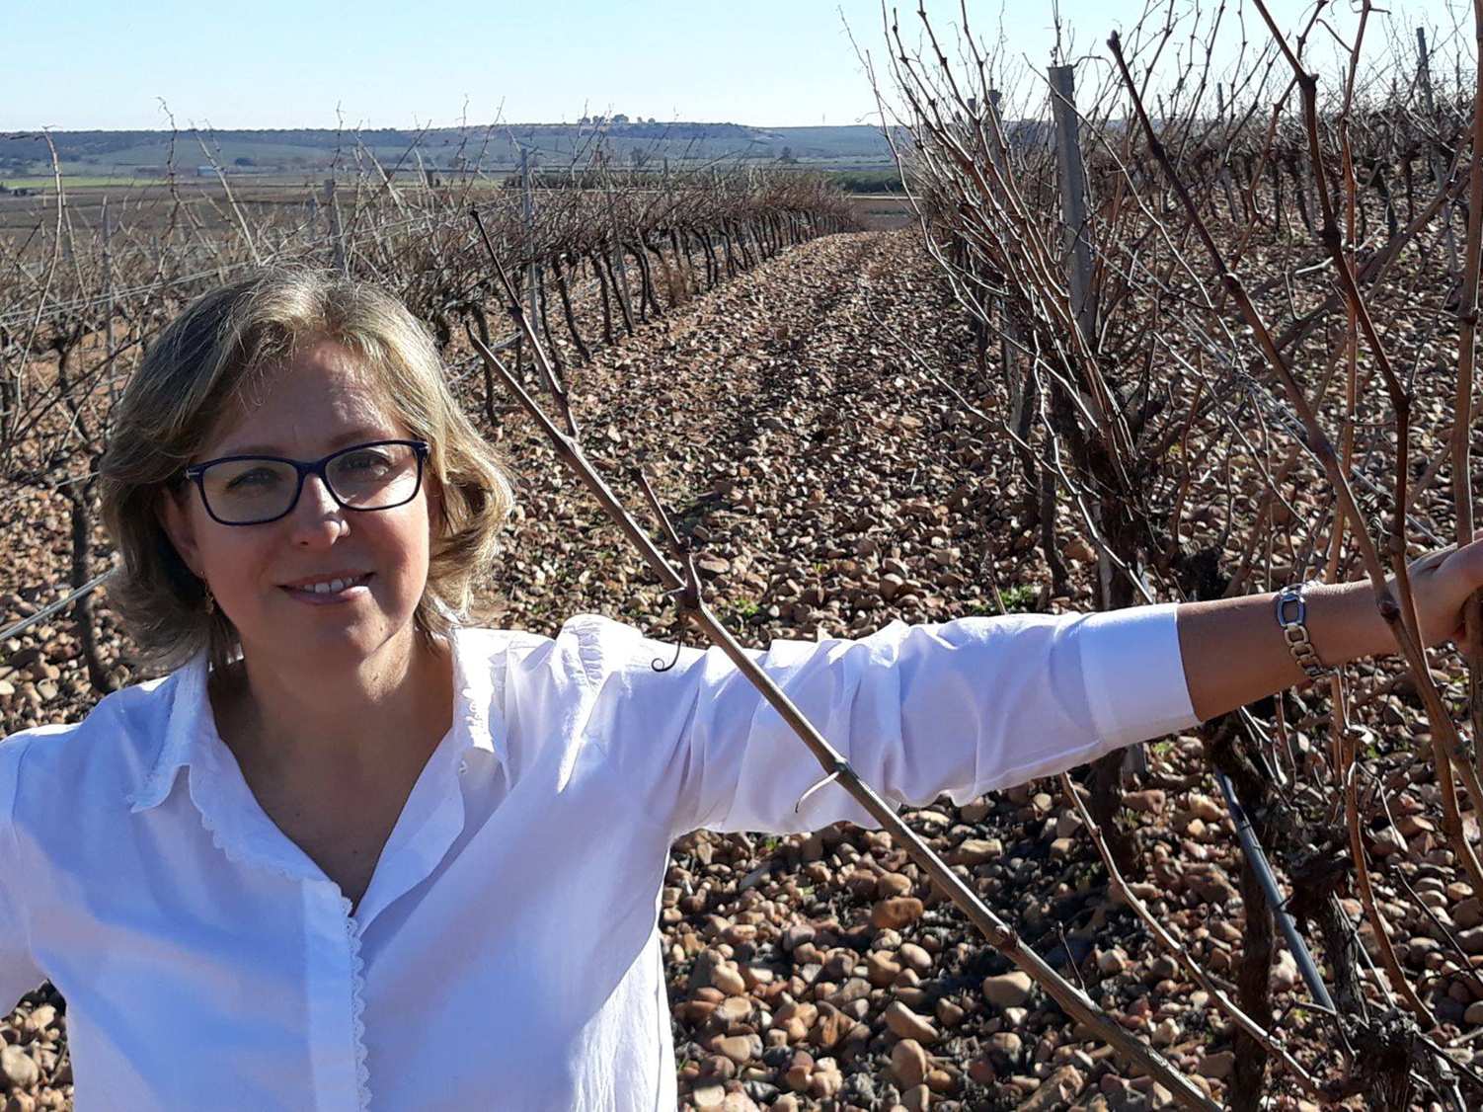
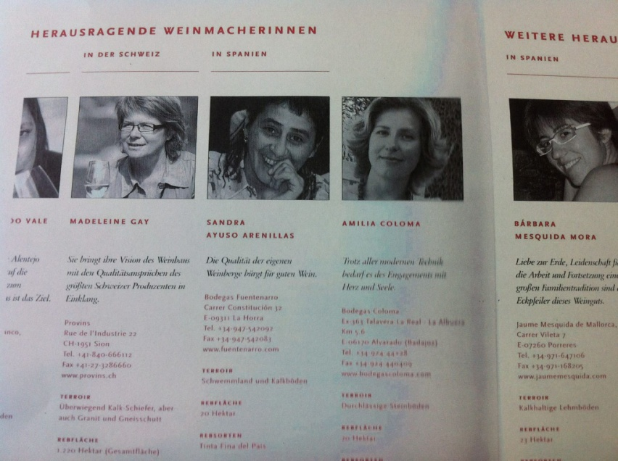
Our Winemaker, Amelia Coloma: considered one of the best 10 Female Winemakers in Spain.
Amelia Coloma takes care of the whole production process from the vineyard to the table.
Swiss editor AT Verlag published this book about the best 40 female winemakers in contemporary wine industry.

Slide 9
Enjoy the best taste, modern wines at the cutting edge of tradition

Slide 10

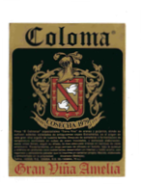
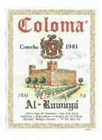
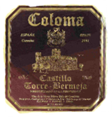
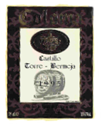

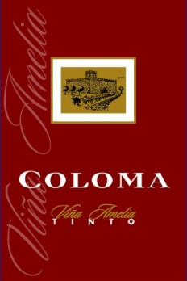
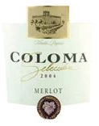
55 years and 3 generations dedicated to grape growing and winemaking.
1979
1981
1991
1995
1999
2002
2004

Slide 11

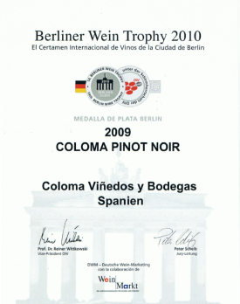

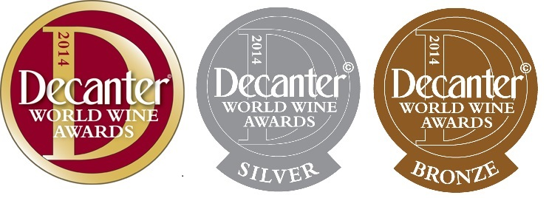
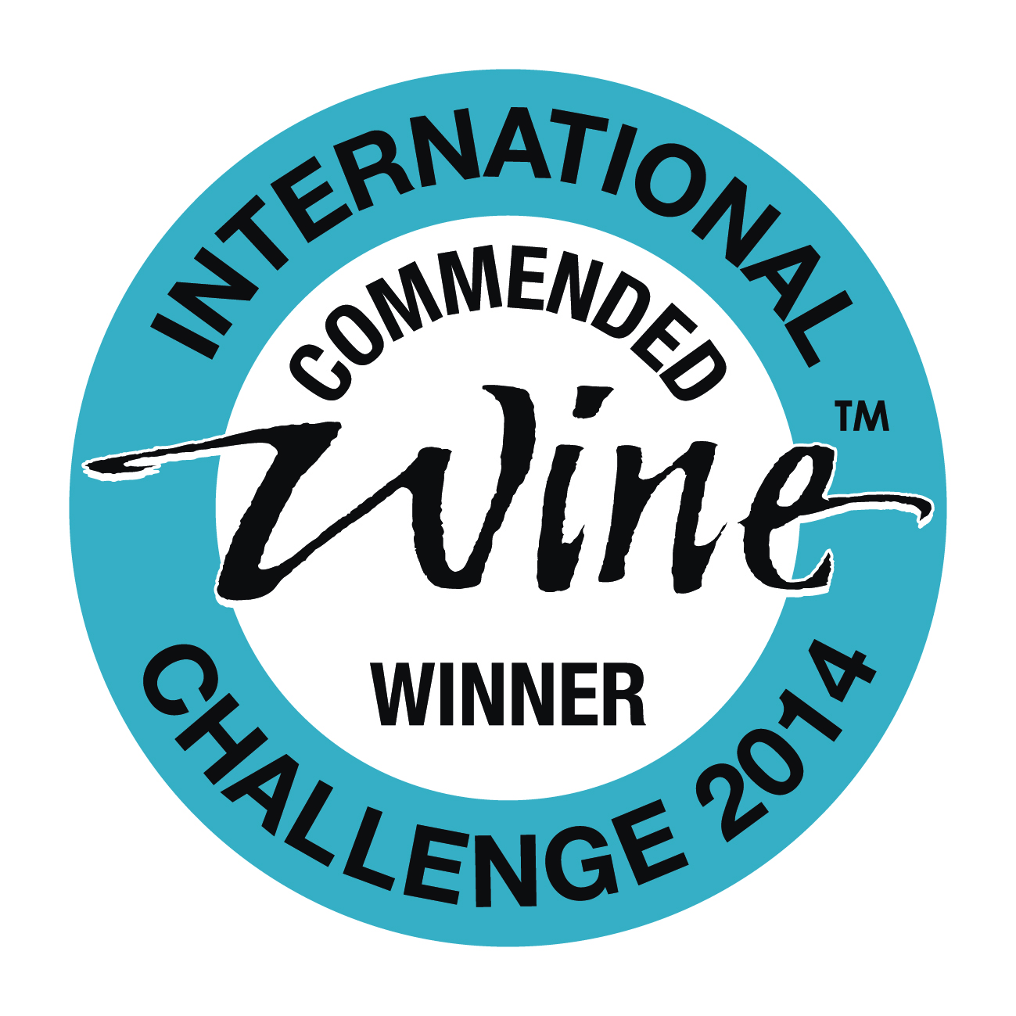

Robert Parker (Feb 2017) 87 points
Coloma Garnacha Roja (100% varietal) is an unoaked Spanish fruit bomb. Purple-colored, it exhibits aromas and flavors of cherry, plum and black raspberry. Full-flavored and ripe, this terrific value should drink well over the next 18 months.
Jancis Robinson: (May 2020) 16.5 points
Coloma, Garnacha Seleccion Vino de la Tierra de Extremadura
45-year-old vines grown on alluvial soils near the river Guadiana.
Dark – the color of black cherries. Lifted, pure Garnacha character – smells ripe and spicy, peppery and warm-hearted, with dark-fruit sweetness. Lovely fruit. Very juicy, dark cherry and blackcurrant flavors, primary and bright but made more sophisticated by fine, firm, dry fruit tannins rounded out by fruit sweetness on the finish.
Ratings:
Awards:
Silver Medal ViniEspaña Award 2021
Berlin Wine Trophy
Silver Medal 2010
Gold medal Sakura awards 2019
Decanter Wine Contest 2014
Silver and Bronze Medal
IWC 2014
Commended Medal
Gold Medal 2015

