Slide 1
OBIKWA Background
OBiKWA wines have been launched to the international market in 2002 and have rolled out to South Africa in 2009. Today it is available in more than 43 countries globally.
Since launch in 2002, this ethnic inspired brand has shown very positive growth trends.
The new packaging portraits a more modern and premium look and feel with excellent stand out on shelf
Since launch in 2002 the concept has been tweaked slightly to fit various initiatives such as eco-packaging trends (Light weight)
OBiKWA was the 1st SA wine to use the ultra light weight bottle and the brand has leverage this eco-friendly innovation very successfully TTL and on-pack. Many other global brands have now followed this trend.
The pack upgrade has created fresh and exciting hype around the brand.

Slide 2
USP’s
Wine
Easy-drinking quality wines, the perfect choice for adventurous lovers of life and those looking for something a little different
Great wines at a commercial price point
Expressive varietal characteristics
Excellent value everyday drinking wines
Pack
Contemporary and modern pack
Excellent stand out on shelf
SKUS Available in Europe current are:-
Whites; Chenin, Chard and Sauv blanc
Reds; Cabernet, Merlot, Pinotage and Shiraz
Rose; Pinotage Rose

Slide 3
OBIKWA PACKAGING EVOLUTION
NEW premium look and feel
More premium & modern look
Greater consumer proposition
Excellent shelf standout of the brand name
Value for money
Current packaging
Rational for project
The brand’s packaging has not evolved along with
International competitors & consumer preference.
The brand remained stagnant and outdated with its
critter packaging.

Slide 4
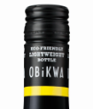
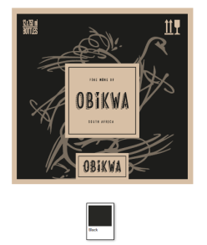
OBIKWA PACKAGING EVOLUTION
Closure = move to one colour
Updated design
Cut case example
Current outers = generic red, white and Rose
NEW Outer carton= one colour black on kraft

