Slide 1
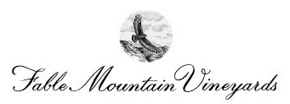
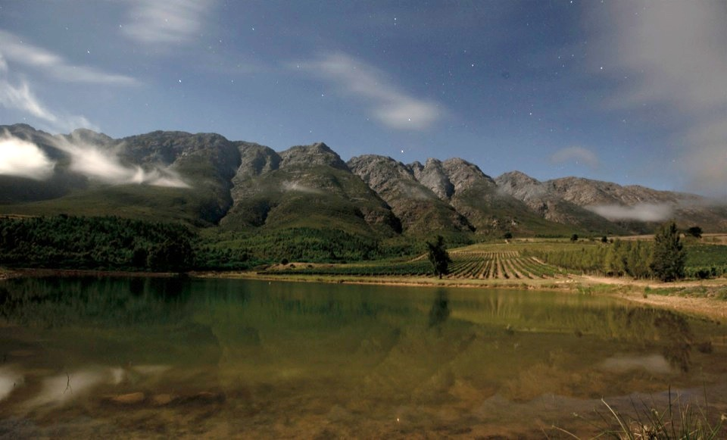

Slide 2
Fable Mountain Vineyards is set in a remote and magical place on the edge of a wilderness reserve. It is a place where the Leopards hide, Jackal Birds circle and Baboons play. It is here that the winegrowers pursue perfection from the vineyard to the cellar, bringing you compelling wines of great distinction.

Slide 3
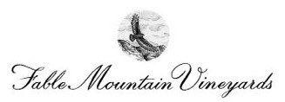
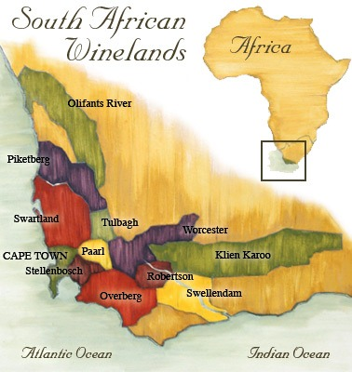
Located up against the rugged slopes of the Witzenberg Mountain range in the Tulbagh region of South Africa, Fable focuses on producing pure expressions of Rhône varieties.

Slide 4
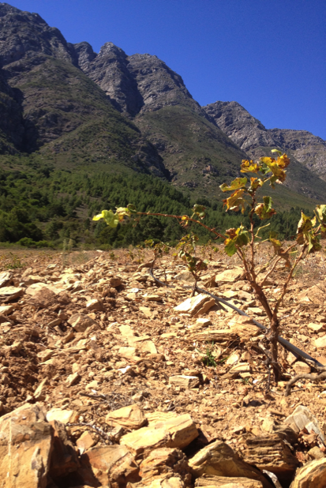
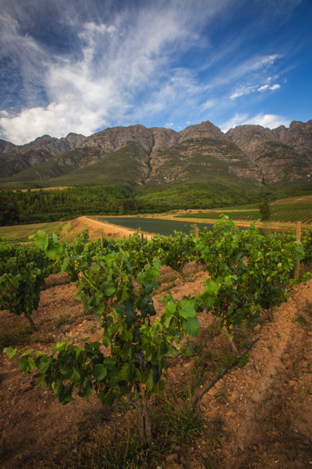

Slide 5
Vineyard
At elevations from 1,300 – 2,130 feet we have 79 acres of Syrah, Mourvèdre and Grenache noir high up on the edge of a Wilderness Nature Reserve
The vines struggle without the luxury of much soil which rests on a bed of ancient vertical shale.
The mountains behind Fable tower over the vines and its influence is critical to the uniqueness of our site.
Every morning the Mountain casts a shadow over the farm, which has a cooling effect. In the Summer this allows the grapes to ripen slowly, retaining great natural acidity, and in winter the snowy peak helps keep the vines dormant longer.
The site is very challenging with bush fires, extreme weather, wild animals and natural dangers always present during the growing season.
We use a biodynamic and a deep agro-ecological approach to farming to ensure that we maintain the integrity of the site.

Slide 6
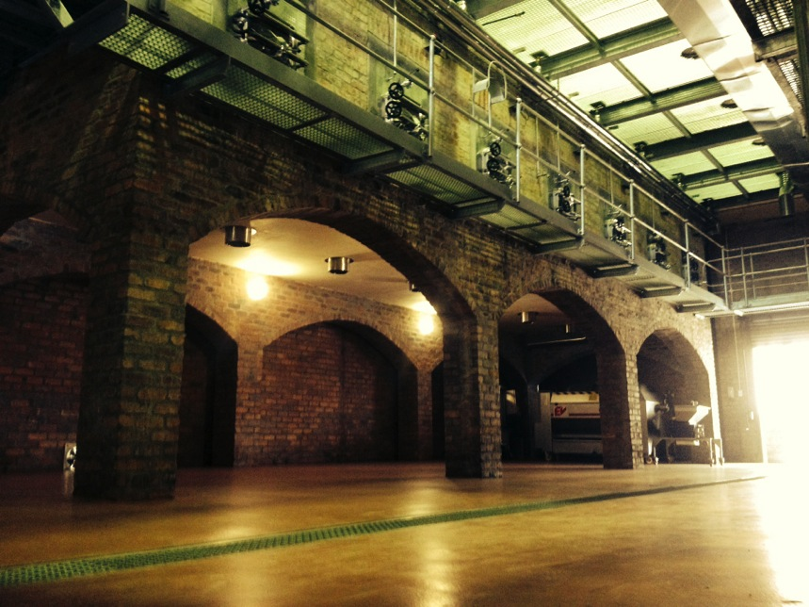

Slide 7
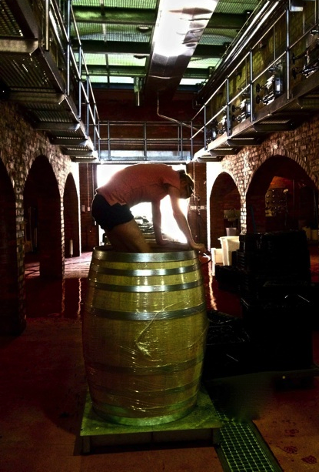
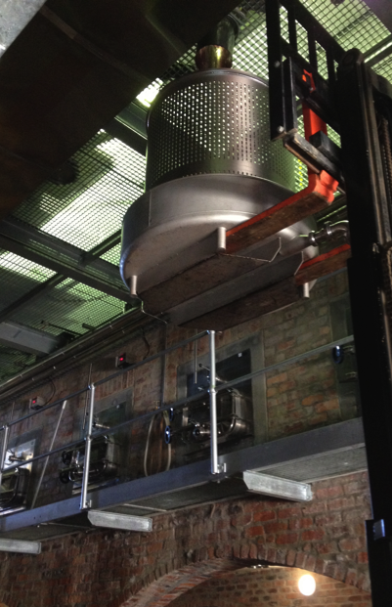

Slide 8
Winery
Our renovated gravity fed cellar combines the best of the old and new world: the latest equipment and knowledge with traditional techniques.
Central to the winery design is the ability to process many small parcels of fruit.
We selectively harvest only small sections of the vineyard . They are all handled separately and differently from fermentation to barrel. This ensures a full array of components and options come blending.
Our gravity fed cellar allows us to keep pumping to a minimum. It is very hands on, with bunch and berry sorting, only hand plunge downs, and we carry out long macerations for up to 4-6 weeks before pressing.
Our philosophy in the cellar is to enhance what we helped create in the vineyard by using minimal intervention and additives, as well as gentle extraction techniques. This helps to bring out the fruits true qualities and creates wines of great expression, subtlety, power and balance. It also helps us toward our goal of producing some of Africa’s most sort after wines.

Slide 9
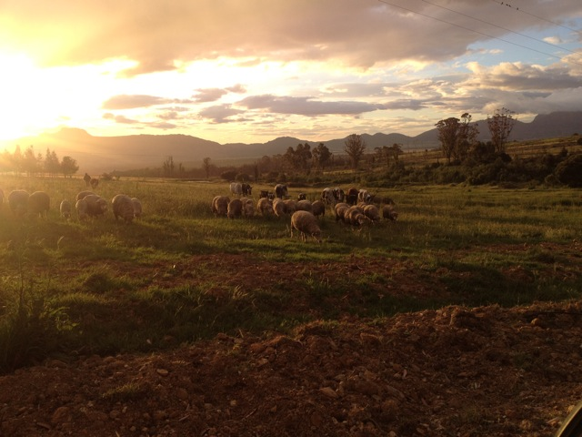

Slide 10
Farm
At Fable, we believe in a diversified farm system promoting both stability and fertility.
As part of this system we have integrated animals onto the farm. We have a herd of indigenous Nguni cattle, around a hundred Merino sheep and a few pigs.
All our animals are pasture fed, and are completely free range. They have a shepherd who looks after them during the day and at night they are kept in an enclosure to help keep them safe from leopards, caracals and foxes.
The animal manure is used in our soil health program. They are allowed to graze the vineyards in winter, and in the summer we use their manure combined with garden and winery waste to generate biodynamic compost.
The animals not only look good, they taste good too! Meat can be purchased from the farm.

Slide 11
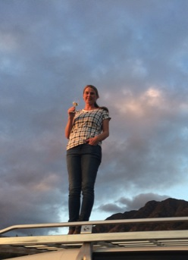
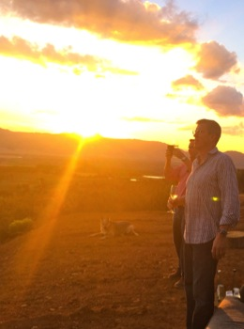
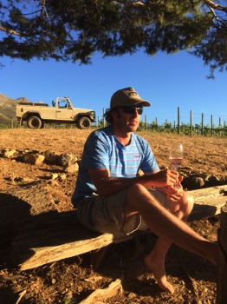
People
Rebecca Tanner
Winegrower
Paul Nicholls
Winegrower
Charles Banks
Vintner

Slide 12
Jackal Bird 2012
Jackal Bird is named after the large raptors that have made their home at Fable. We see them most afternoons as they catch the thermals soaring high above the mountains.
The wine is a blend of old vine Chenin blanc, Grenache blanc, Roussanne, Viognier and Chardonnay.
The Jackal Bird has a slightly different philosophy, whereas the focus for the reds is more about the expression of the vineyard the Jackal Bird is more a winemaker's wine in that it is all about the blend.
The base is old vine Chenin Blanc from mostly the Swartland but the other varietals, added to give spice perfume and interest. are sourced from a variety of different sites across the Western Cape.
The fruit is all hand harvested, whole bunch pressed and naturally fermented in a mixture of concrete eggs, oak and stainless steel.
It is an artisanal wine with an aromatic delicacy and textural elegance.
Production: 1,500 cases

Slide 13
Nigh Sky 2011
Nights on the farm are spectacular; as we are so isolated, there is no light pollution, so the stars put on a grand show. With the moon rising up behind the mountains it is truly mesmerizing.
The Night Sky wine is a blend of Syrah, Mourvèdre and Grenache.
The grapes are mostly sourced from the Estate. They are harvested in the cool of the early morning and the crushed into small open top fermenters.
The wines are naturally fermented and hand plunged as well as long macerated on skins for up to four to eight weeks post fermentation.
The wine is then aged for 24 months in large oak barrels.
Production: 1,500 cases

Slide 14
Syrah 2011
100% Estate grown.
This wine represents a pure expression of Syrah from the Estate.
Only the best parcels are selected to go into this our top wine.
The grapes are harvested in the cool of the early morning and then crushed into large format barrels.
Natural fermentation is allowed to take place after which they undergo eight to twelve weeks on skins post fermentation.
The wine is then aged for 24 months in large oak.
Production: 500 cases

Slide 15
