Slide 1


VASCo presentation and tasting.
Ternat, 5th September 2016
Introducing Viña Errazuriz
Your new Chilean partner

Slide 2
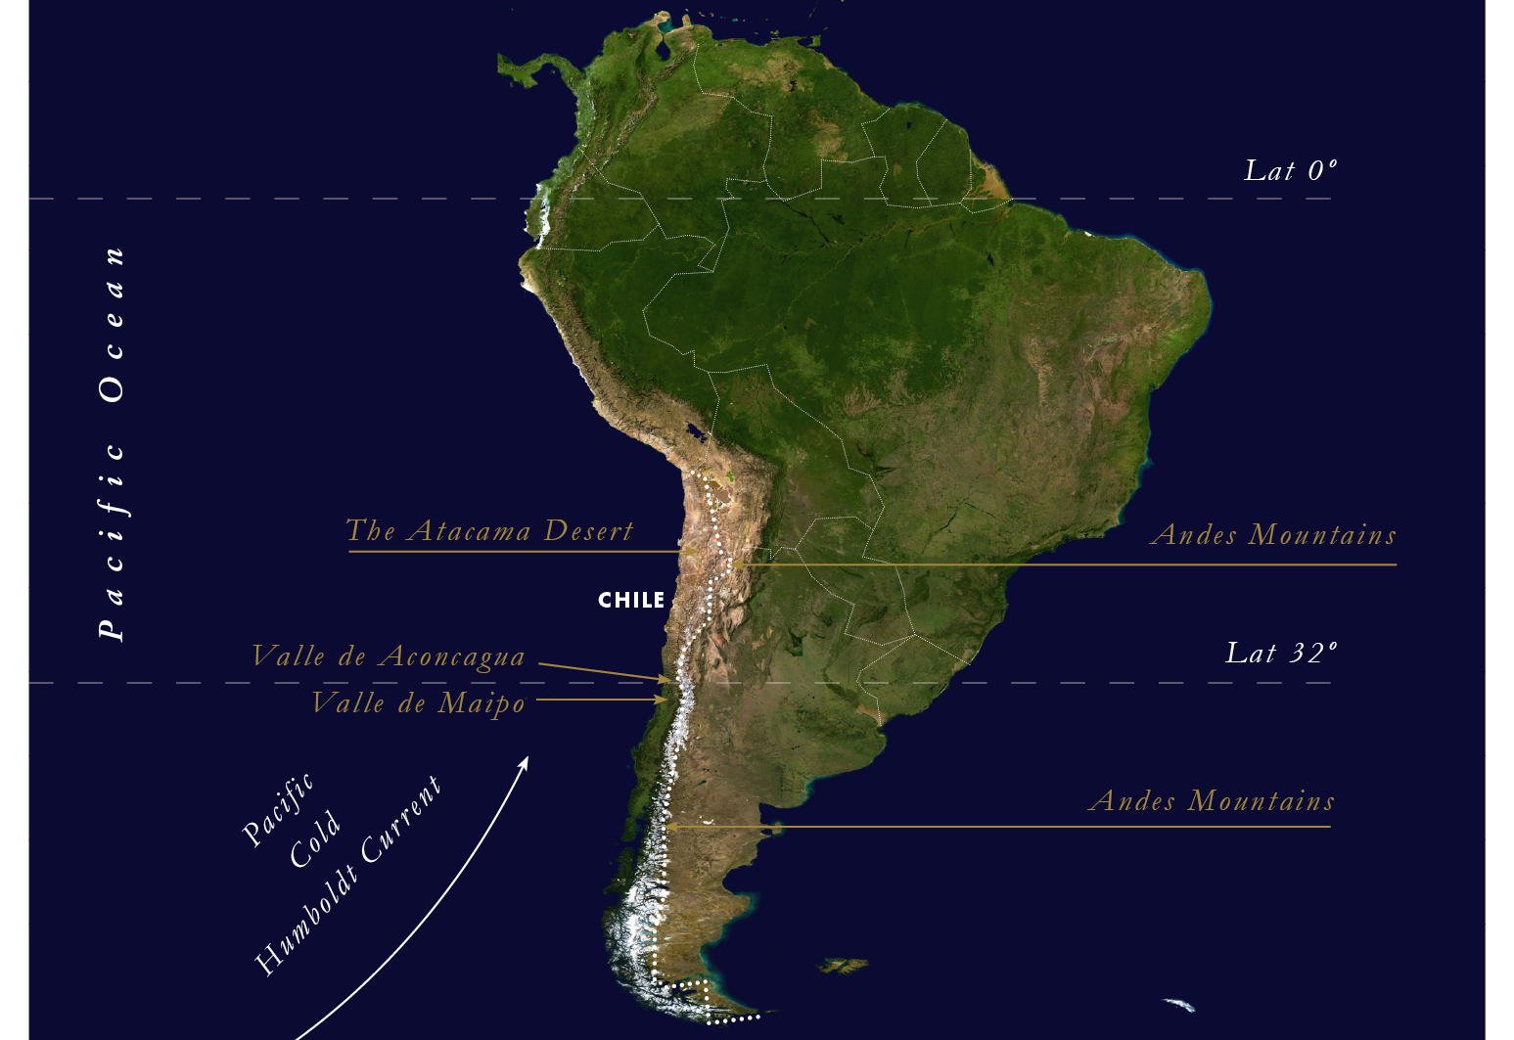

Slide 3
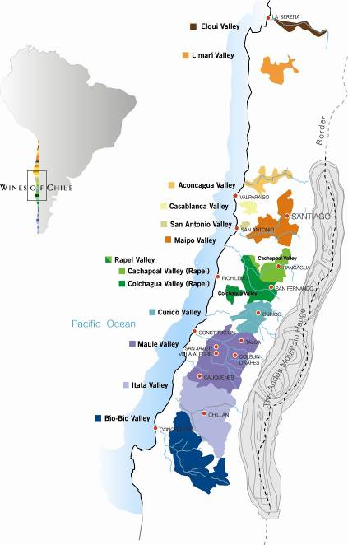
30º
40º

Slide 4
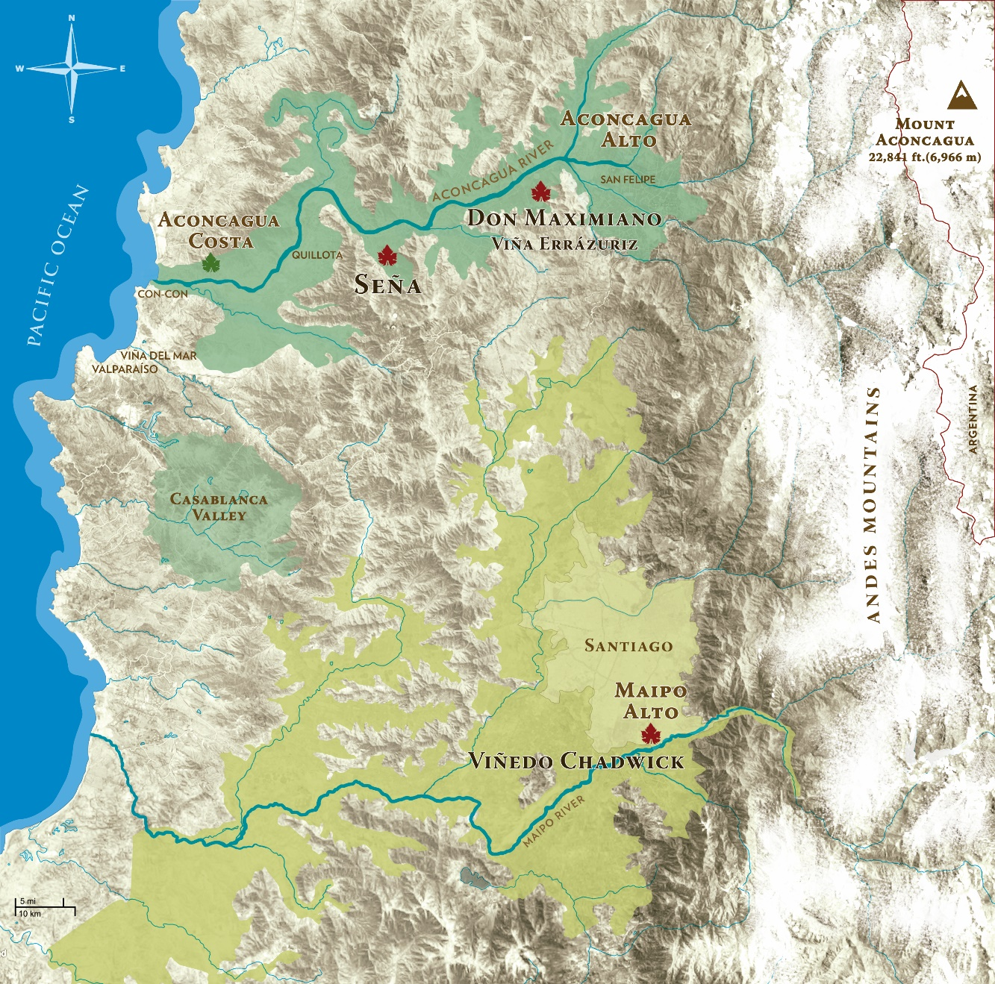

Slide 5
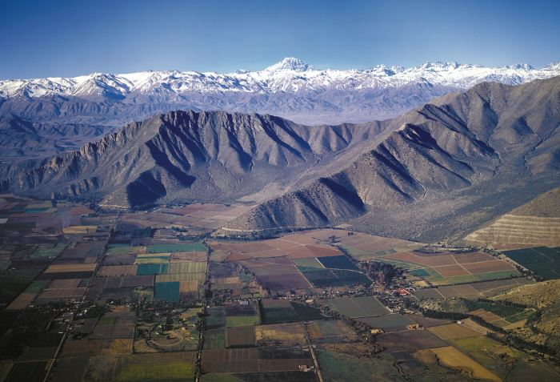
ACONCAGUA PEAK: TOWERING OVER THE VALLE DE ACONCAGUA

Slide 6
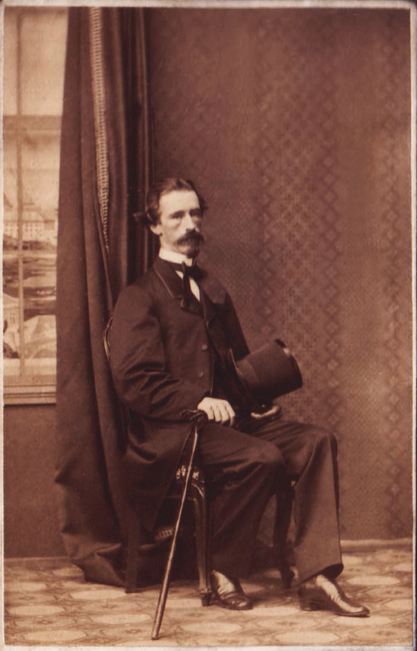
  DON MAXIMIANO ERRAZURIZ: OUR FOUNDER

Slide 7
What is the significance of this?
Innovative/ pioneering
Quality focussed
  “From the best land the best wine”
Independent and family owned and run
  now by the visionary Eduardo Chadwick.
Notes:
Producing annually about 550,000 cases

Slide 8
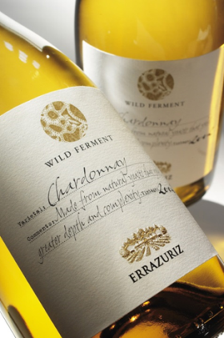
Other ‘firsts’
1985: First hillside plantations in Chile.
1991: First steep hill drip irrigated vineyard in Chile; Don Maximiano Estate.
  1994: Shiraz first introduction to Chile.
1997: First Chilean winery to use indigenous yeasts
1999: Sangiovese first introduction to Chile.
2004: Packaging - use of screwcap closure
2005: Viña Errazuriz starts planting in Aconcagua Costa
2009: Introduction of lightweight glass for Estates and Max Reserva

Slide 9
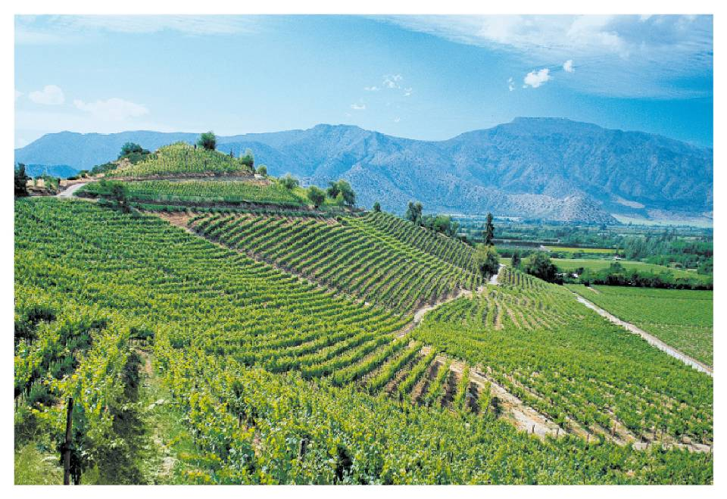
VIÑA ERRAZURIZ: DON MAXIMIANO HILLSIDE TERROIR

Slide 10
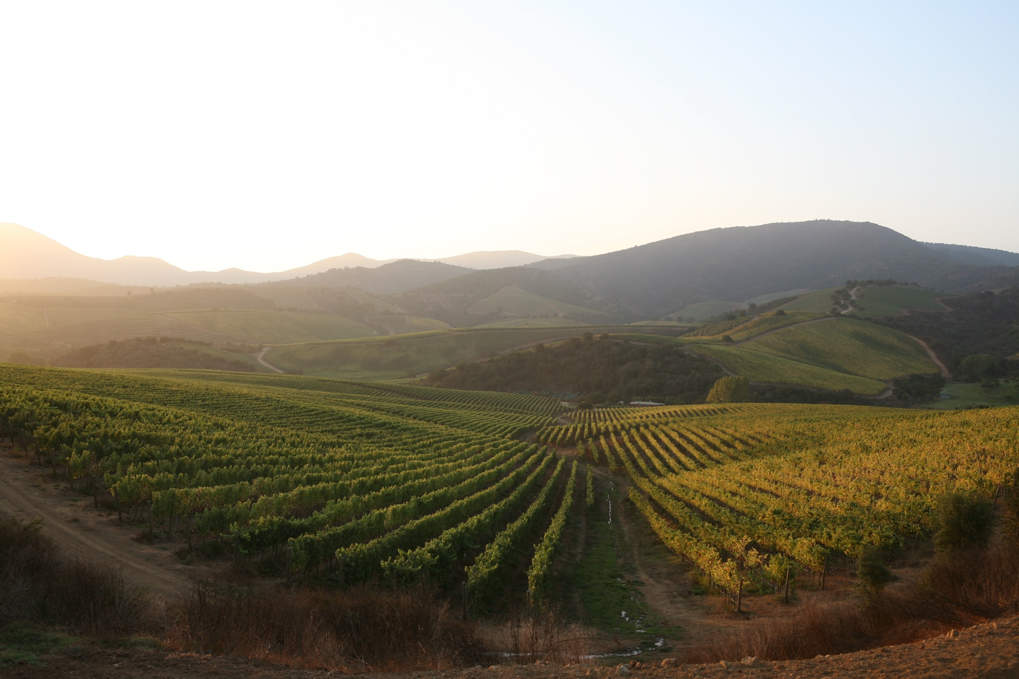
ACONCAGUA COSTA: COOL CLIMATE WINES
AC
ERRAZURIZ ESTATE WINES ERRAZURIZ ESTATE WINES

Slide 11
Our accolades…..
“Along with Concha y Toro, which dominates Chilean wine from a quantity perspective, Errazuriz provides a quality benchmark.” Decanter Magazine, June 2005
Best super-premium red and overall Best Wine in Show, Don Maximiano Founders Reserve 2010, 10th Annual Wines of Chile Awards (2013).
Best super-premium red and overall Best Wine in Show, Don Maximiano Founders Reserve 2011, 11th Annual Wines of Chile Awards (2014).

Slide 13
VCH 100 points graphic to be inserted

Slide 14
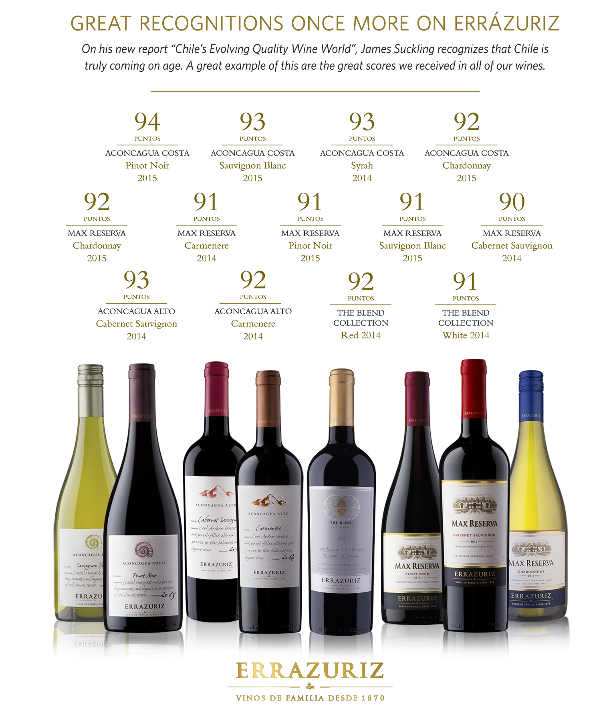

Slide 15
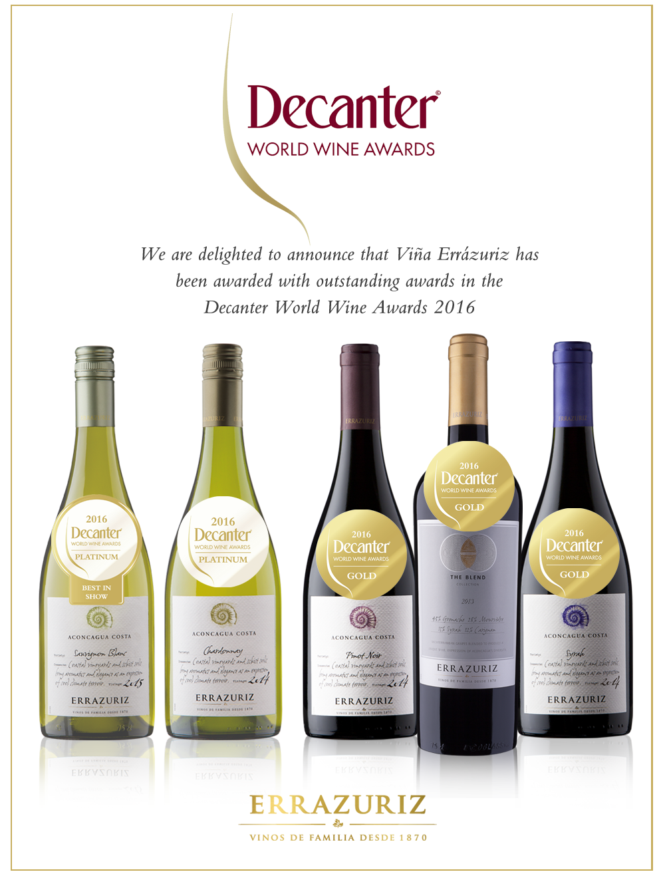

Slide 17


Slide 18
Viticulture Strategy
Self sufficient in grapes.
All sites are orientated towards quality not yield.
Precision viticulture as part of sustainability.
Winemakers spend more than 40% of their time in the vineyards.
Picking dates determined by the winemakers. For some wines now picking up to a month earlier than we did from 2010 vintage for example.
Aconcagua Costa vineyard. Unique to us.
Innovations:
  Flood irrigation trials
  Pinot Grigio, Tempranillo, Marselan
Notes:
390 ha under vine. 9 sites. Cone and rootstock trials.

Slide 19
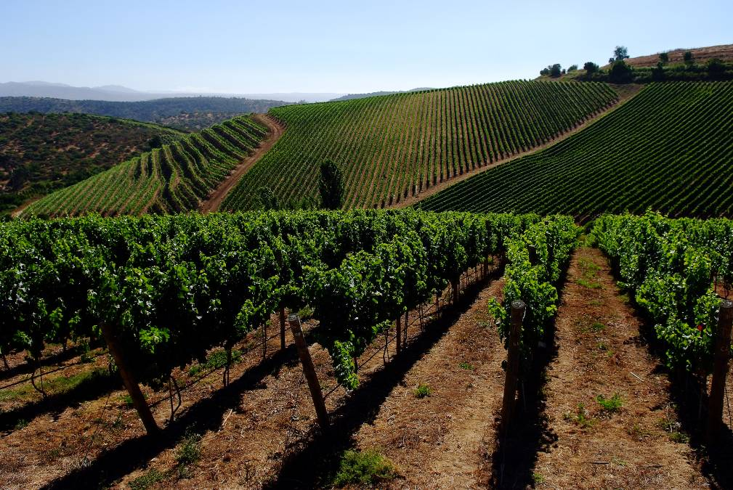
ACONGACUA COSTA (2009)

Slide 20
Winemaking strategy…..
State of the art, US$50m winery opened in 2010:
  Only for our Icon wines
  Gravity flow, temperature controlled, sustainable
New 222 tank Max Reserva winery commissioned at the same time.
Double sorting tables
Oak:
  Less used, and less new oak used
  Proportionally more French oak used than ever before
  Coopers: Saury, Taransaud and Adour – the best
Changing styles:
  Less new oak, earlier picked, more emphasis on freshness, aromatics, structure. Less emphasis on ripeness, body, alcohol.
Annual study trip yields additional innovations
  Trials with concrete tanks and wooden eggs

Slide 21
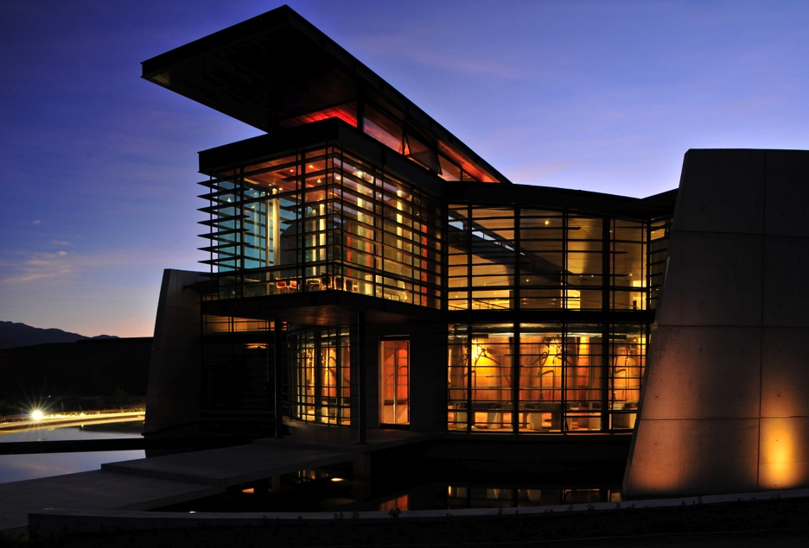
VIÑA ERRAZURIZ: DON MAXIMIANO FLAGSHIP WINERY

Slide 22
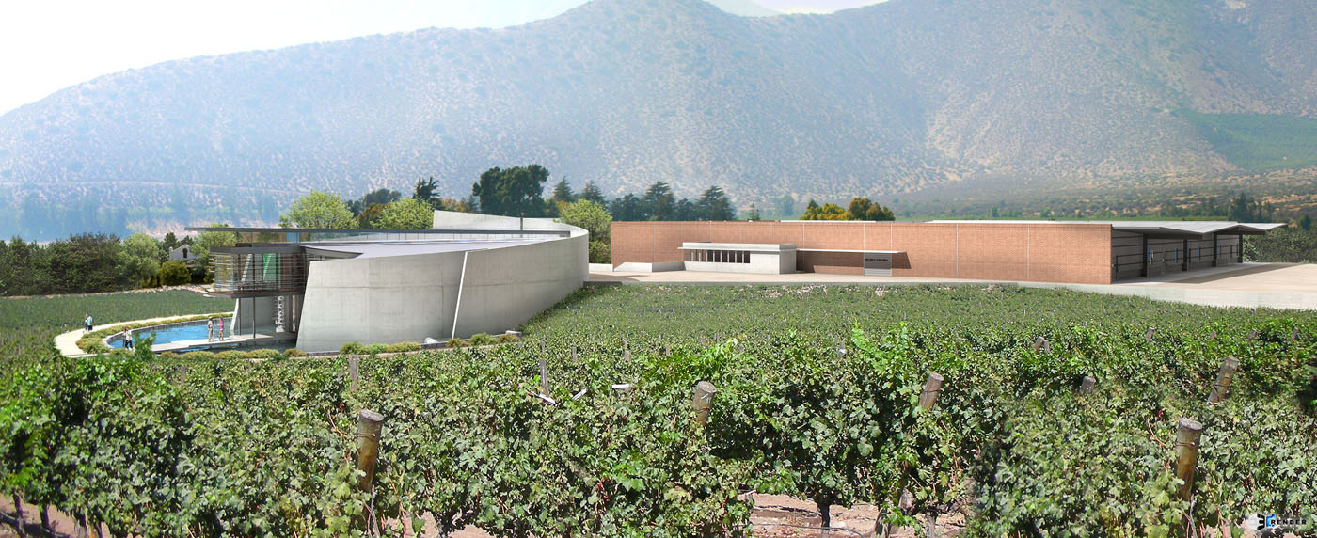
  MAX RESERVA WINERY

Slide 23
People making the wine…..
Francisco Baettig
  Winemaker of the Year 2011, Chilean Guild of Food and Wine Writers
Consultants
  Kym Milne MW
    Formerly of Villa Maria
    Chair of judges at the Sydney International Wine Show
  Louis-Michel Liger-Belair
    Domaine Liger-Belair, Vosne-Romanée

Slide 24
Marketing strategy…..
Things you do hear us say:
  World class, benchmark, best, quality, pioneers
Things you do not hear us say:
  Volume, scale, costs, yields, market share

Slide 25
We have the best quality in the bottle at any price tier because:
Our business model and our viticulture, winemaking and marketing strategies all start with our Flagship wines.
We are not focussed on making the most volume or being the lowest cost operator.
We own our own vineyards – we do not buy grapes or wine.
We employ the best people.
We continue to innovate and invest to improve quality.
With the recognition
Notes:
Icon focus = quality through the tiers because of trickle down of quality grapes, because of application of best practice, and because of perception of reputation for making quality.

Slide 26
The pitch – “why should I list Errazuriz?”
We believe we have superior quality in the bottle at any price tier
  Try it with your customers
Wine style evolution – elegant, contemporary, food friendly Chilean wines.
Proven success – a long and successful history in Europe – and powerful accolades
We continue to innovate to improve and demonstrate our quality
Support with events/ tastings/ staff training
Notes:
With JA for 22 years

Slide 27
Thank you

