Slide 1
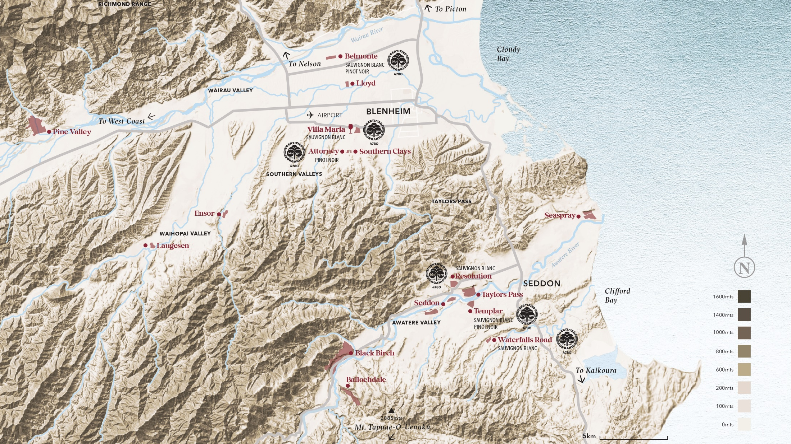

Slide 2
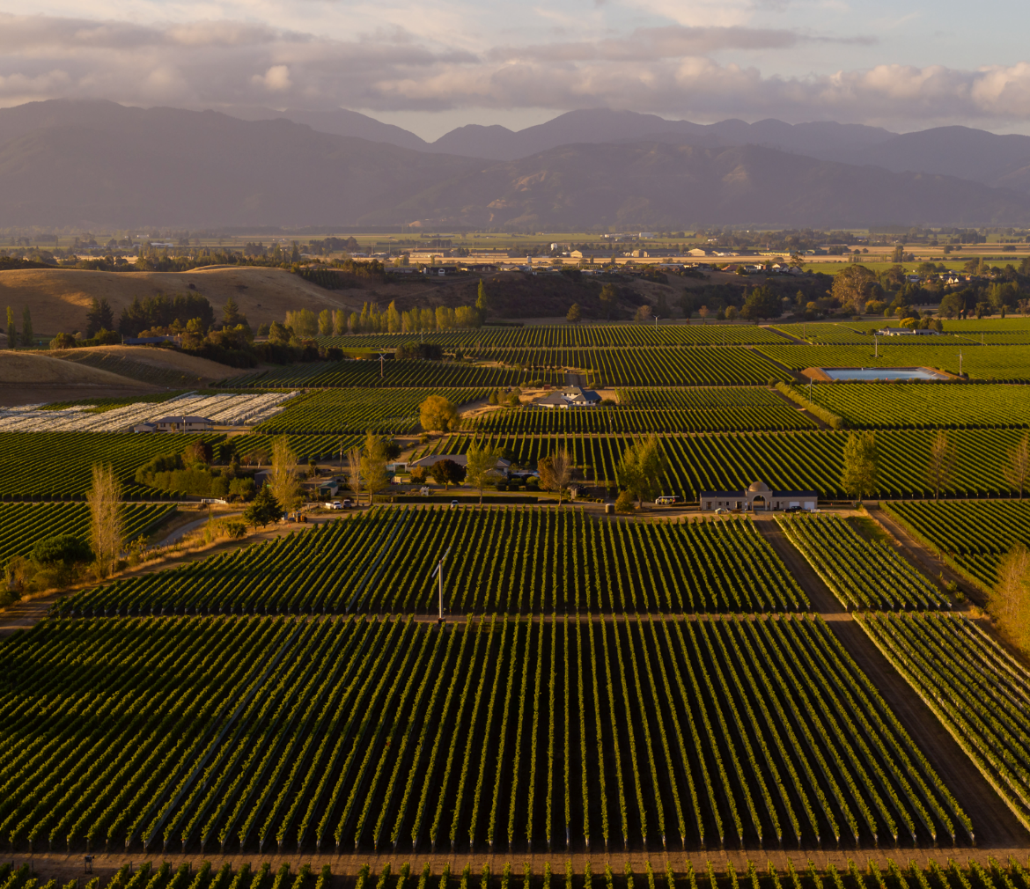
Reserve Wairau Valley, Marlborough Sauvignon Blanc
With our vast collection of vineyards in the Wairau Valley, we were able to master the concentration of flavours and acidity to deliver a famously tropical style of Marlborough Sauvignon Blanc cherished around the world.
The Wairau Valley sub-region is Marlborough’s predominant area for grape growing and is warmer and more protected than its other valleys. Later ripening sites in the upper Wairau Valley contribute to this wines pungent ripe passionfruit flavours balanced by the freshness and greener thiol character of the lower Wairau Valley. Reserve Wairau Valley is an exceptional sub-regional expression of Marlborough Sauvignon Blanc and is one of the most popular and iconic wines in our portfolio with a cult following.
Bursting with aromatic tropical fruit characters found in this warmer sub-region. This wine displays powerful aromas of blackcurrant, passionfruit and ripe rock-melon. The palate has an enticing array of ripe citrus fruits mixed with pungent herbs such as fresh rosemary, finishing with subtle acidity.
ACCOLADES & ACCLAIMS
2022 VINTAGE 90 POINTS – JAMES SUCKLING
2022 VINTAGE 95 POINTS – CAMERON DOUGLAS
2022 VINTAGE GOLD – NEW ZEALAND INTERNATIONAL WINE SHOW
“This is all passion fruit and guava, a medium to full-bodied wine that offers a ripe, round feel in the mouth, no hard edges, and a long, luxurious finish” WINE ADVOCATE

Slide 3
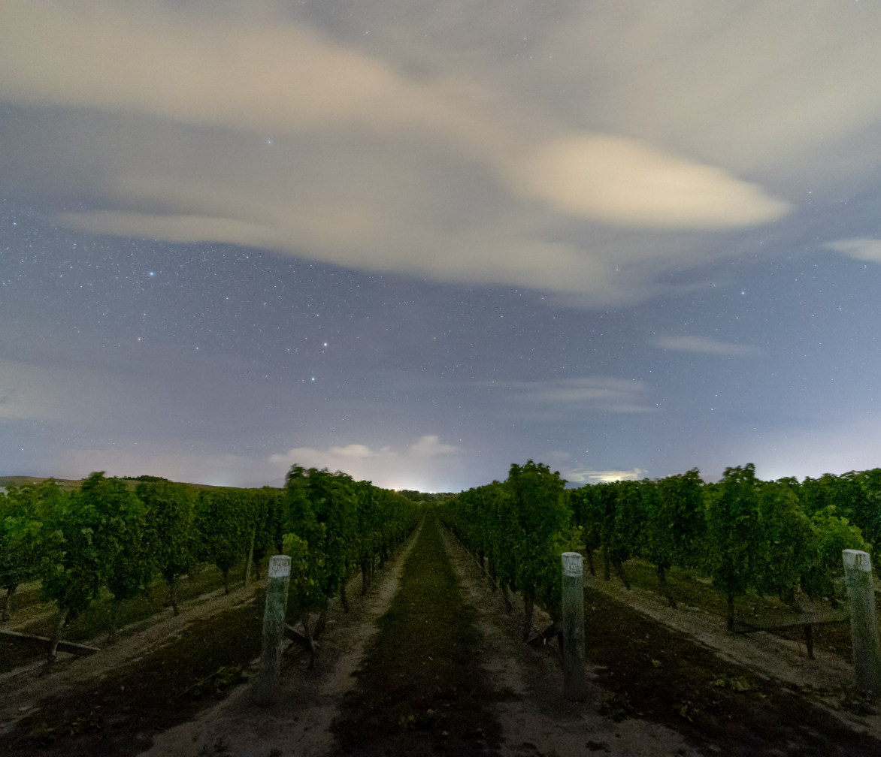
Reserve Marlborough Pinot Noir
Handpicked and blended from both the Wairau and Awatere valleys in Marlborough ensures each vintage is consistently balanced between ripeness and ‘chewy’ acidity and structure befitting of our ‘Reserve’ distinction.
The fruit from this Reserve Pinot Noir was handpicked from premium Marlborough vineyards planted in the clay soils of the Wairau Valley and free-draining silt soils of the cooler Awatere Valley before being an extended maturation period in French oak barriques.
This wine showcases bright floral aromas as well as fresh cherries offset by an inviting mixture of dark chocolate and hints of fresh portobello mushrooms on the palate. This complex and complete wine shows purity and richness, resplendent with soft velvety tannins and French oak influence it is suitable for extended time in the cellar to develop a more savoury, earthy character.
ACCOLADES & ACCLAIMS
2020 VINTAGE 92 POINTS – JAMES SUCKLING
2018 VINTAGE 95 POINTS – WINE ORBIT
2018 VINTAGE 93 POINTS – CAMERON DOUGLAS MS
“Gorgeously fruited and elegantly complex. It's succulent and supple on the palate, finely textured mouthfeel and long soothing finish. Beautifully styled and harmonious” WINE ORBIT

Slide 4
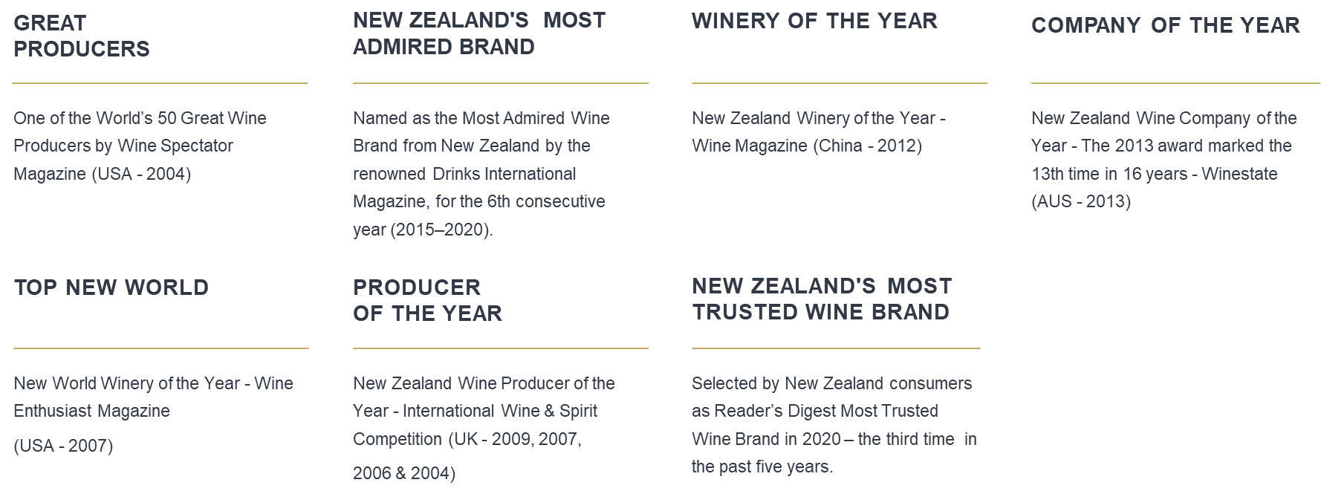
Our Accolades
A quality benchmark of New Zealand’s Wine Industry.

