Slide 1
GIFFARD AMAZON – BRAND STORE & A+ PAGES

Slide 2
BRAND STORE
https://www.amazon.fr/stores/node/19442380031?_encoding=UTF8&field-lbr_brands_browse-bin=Giffard&ref_=bl_dp_s_web_19442380031

Slide 3
It all began during the very hot summer of 1885…
At that time, Émile Giffard was a pharmacist living in Angers (Val de Loire).
He had an inventive, curious mind, and was a gourmet as well. He took an interest in the digestive and refreshing properties of mint, and ended up concocting a pure, clear and refined white mint liqueur which he promptly put to the test by offering the guests at the Grand Hotel a sip of his cordial as a relief against the heat wave.
Having found instant success, Émile turned his pharmacy into a distillery and named his liqueur Menthe-Pastille, in reference to the tiny mint sweets that were all the rage in those days.
Five generations later, the family business still bears the GIFFARD name and produces on top of Menthe-Pastille, 60 liqueurs & 90 syrups used in the cocktails of the top bartenders around the world. Giffard, it is as well strong environnemental values: from the start, plants are the source of inspiration. La Maison Giffard finds the best varieties of plants and fruits to extract their rich flavours.
[Option Sustainable Development has always been in the heart of Giffard culture: Respecting human and environmental values, and searching permanently for quality since the origin, ensure their sustainability. ]

Slide 4
Liqueurs A+ page
https://www.amazon.fr/Giffard-Fleur-Sureau-Sauvage-70/dp/B00A4EZ822/ref=sr_1_3?__mk_fr_FR=%C3%85M%C3%85%C5%BD%C3%95%C3%91&dchild=1&keywords=giffard&qid=1626270218&s=grocery&sr=1-3

Slide 5
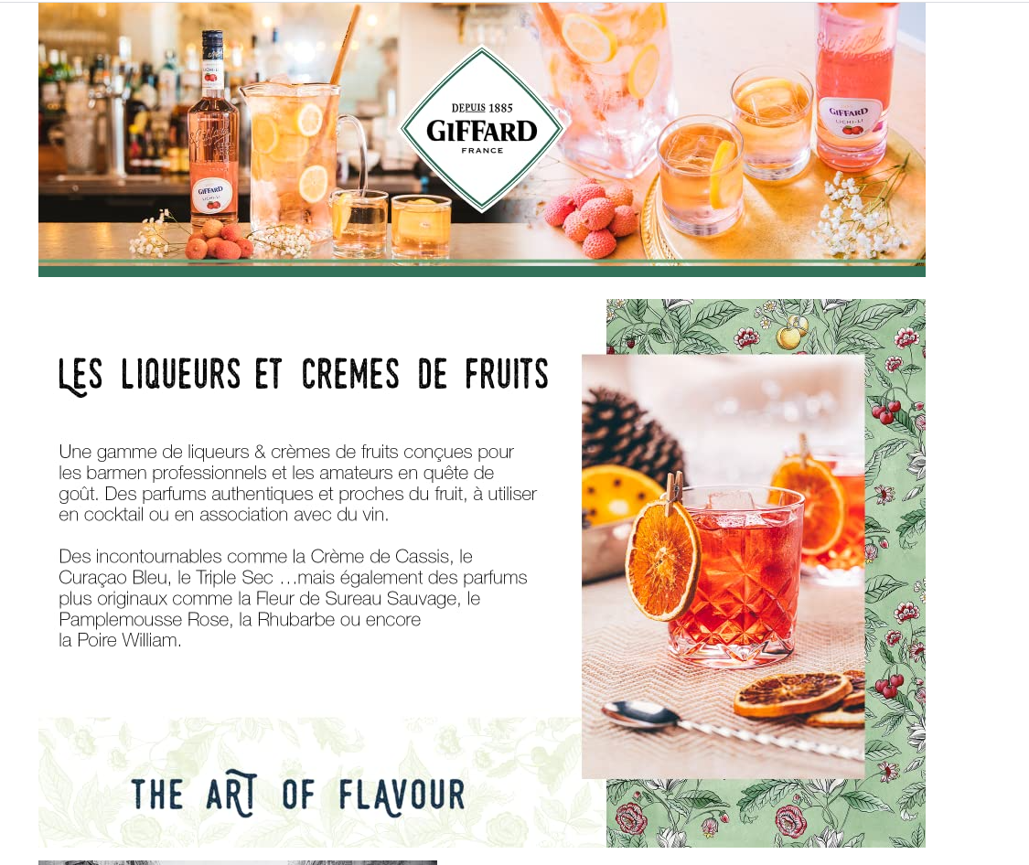
LIQUEURS & CREMES DE FRUITS
A range of liqueurs & crèmes de fruits created for professional bartenders and amateur cocktails lovers looking for taste. Authentic flavours and close to the fruit taste, to use in cocktails or with wine.
From must-have bar ingredients like Crème de Cassis, Blue Curaçao, Triple Sec … to more original flavours such as Wild Elderflower, Pink Grapefruit, Rhubarb or William Pear. [to be adapted with your flavours]

Slide 6
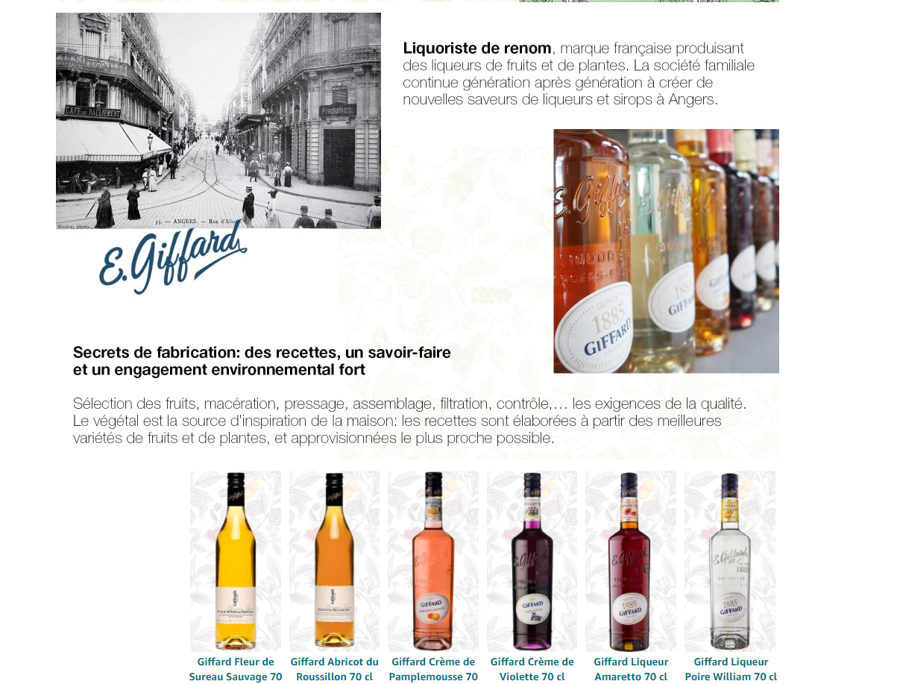
Renowned French Liquorist, producing fruits & plants liqueurs. The family company continues generation after generation to create new flavours of liqueurs and syrups in Angers.
Trade secret: recipes, know-how and strong environmental commitment
Selecting fruits, maceration, pressing, blending, filtration, bottling, control … the requirements for quality.
Plants are Giffard source of inspiration: recipes are created with the best varieties of plants and fruits, and supplied most locally as possible.
Here put your best sellers

Slide 7
Syrups A+ page
https://www.amazon.fr/gp/product/B005QXTQME?pf_rd_r=YE8V9JXFRE8KJH7FSWNJ&pf_rd_p=ed1ef413-005c-474d-837a-434c7d76d0d9&pd_rd_r=a0234855-7451-4f3c-8b59-8efc4e4ed4a5&pd_rd_w=3Qo4p&pd_rd_wg=NXXwX&ref_=pd_gw_unk&th=1

Slide 8
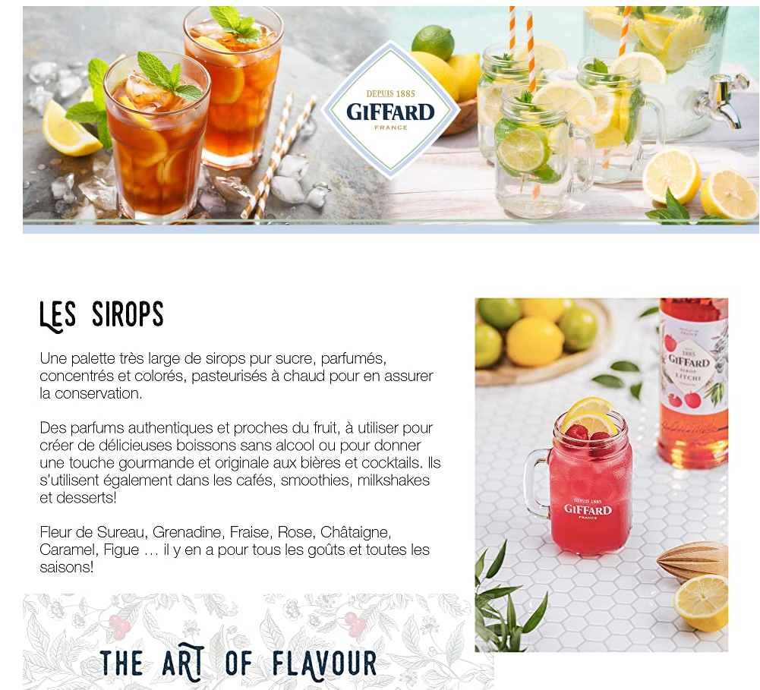
SYRUPS
A very large range of pure sugar, highly flavoured, concentrated and colourful syrups, which have been pasteurized to ensure a perfect preservation.
Authentic flavours, close to the fruit taste, to be used to create delicious non-alcoholic drinks or to give an indulgent and original touch to cocktails and beers.
They are also perfect for coffees, smoothies, milkshakes and desserts!
Elderflower, Grenadine, Strawberries, Rose, Caramel, Chesnut [to be adapted with your flavours] … There are some for all palates and all seasons!

Slide 9
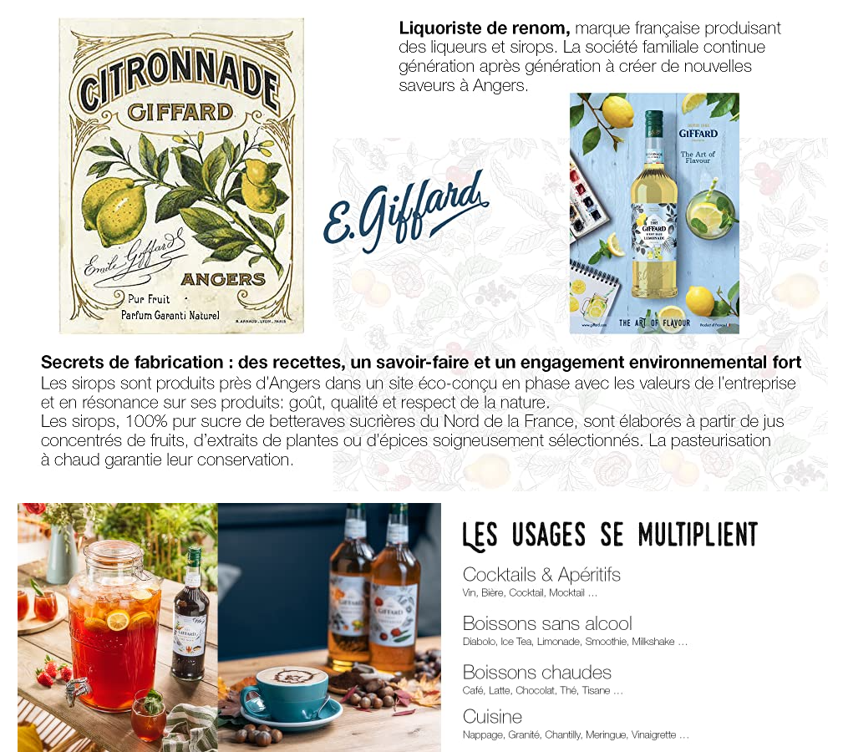
Renowned French Liquorist, producing liqueurs and syrups. The family company continues generation after generation to create new flavours in Angers.
Trade secret: recipes, know-how and strong environmental commitment
Syrups are produced closed to Angers, in a eco-built production site in harmony with the company values and in resonance with its products: taste, quality, and respect for nature.
The syrups, 100% pure sugar from North of France sugar beets, are made from concentrated fruit juices and rigorously selected plants or spices extracts. Hot bottling pasteurization ensures their preservation.
VARIOUS APPLICATIONS
Cocktails & Aperitifs
Wine, Beer, Cocktail, Mocktail …
Non-alcoholic drinks
With water, Ice Tea, Lemonade, Smoothie, Milkshake …
Hot drinks
Coffee, Latte, Chocolate, Tea, Infusion …
Cooking
Dessert, Coating, Granita, Chantilly cream, Meringue, Salad dressing …

Slide 10
Menthe-Pastille A+ page
https://www.amazon.fr/Giffard-Fleur-Sureau-Sauvage-70/dp/B018WDVK3C/ref=sr_1_3?__mk_fr_FR=%C3%85M%C3%85%C5%BD%C3%95%C3%91&dchild=1&keywords=giffard&qid=1626270218&s=grocery&sr=1-3&th=1

Slide 11
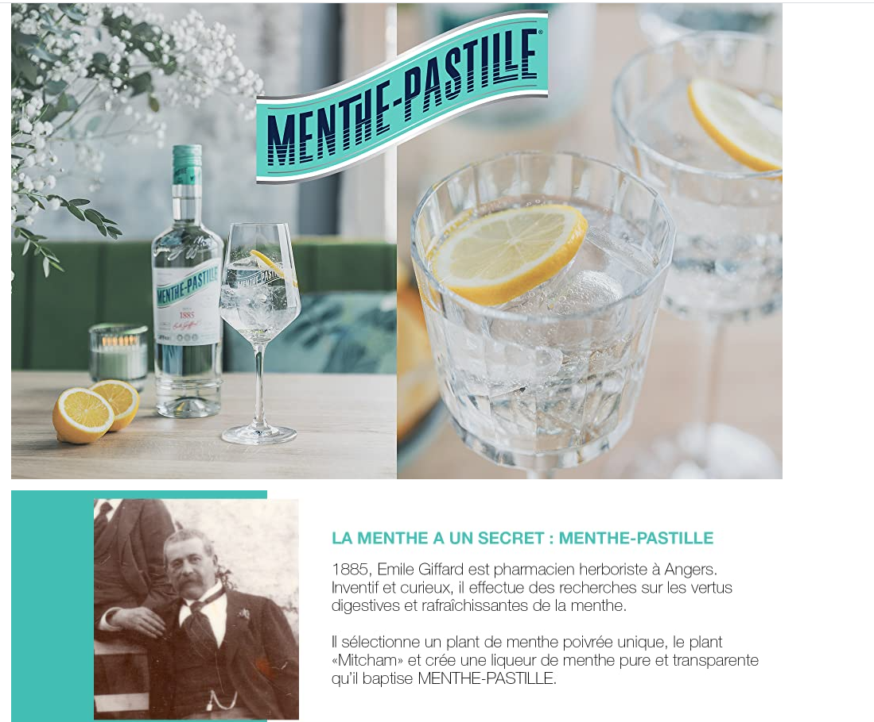
MINT HAS A SECRET: MENTHE-PASTILLE
1885, Emile Giffard is pharmacist and herbalist in Angers. Inventive and curious, he is studying the digestive and refreshing properties of mint.
He selects an unique peppermint plant, « Mitcham » plant and inventes a pure and transparent mint liqueur. He baptises it MENTHE-PASTILLE.

Slide 12
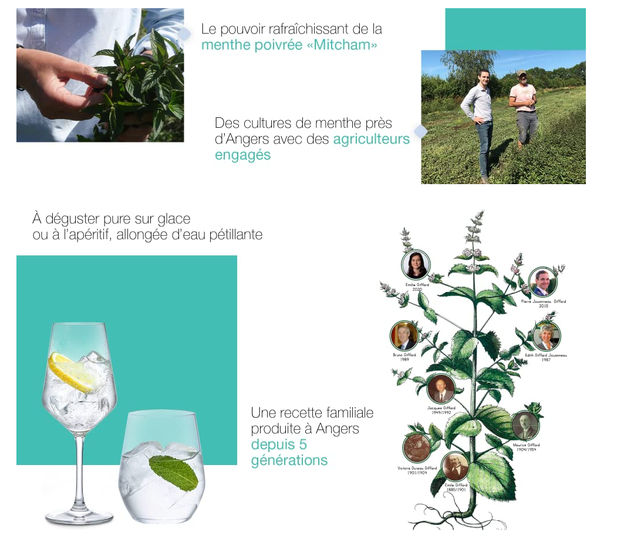
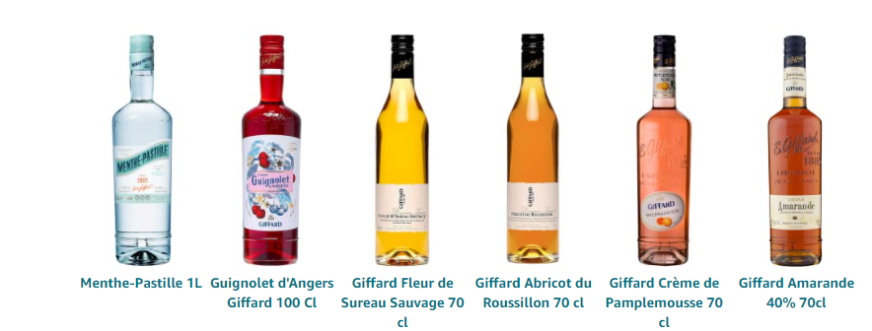
The unique refreshing power of « Mitcham » peppermint
Mint fields on the doorstep of Angers, with committed farmers.
Best enjoyed as a long drink with tonic, soda water or pure over ice.
A family recipe produced in Angers, France since 5 generations.
Here put your best sellers

